Slide 1
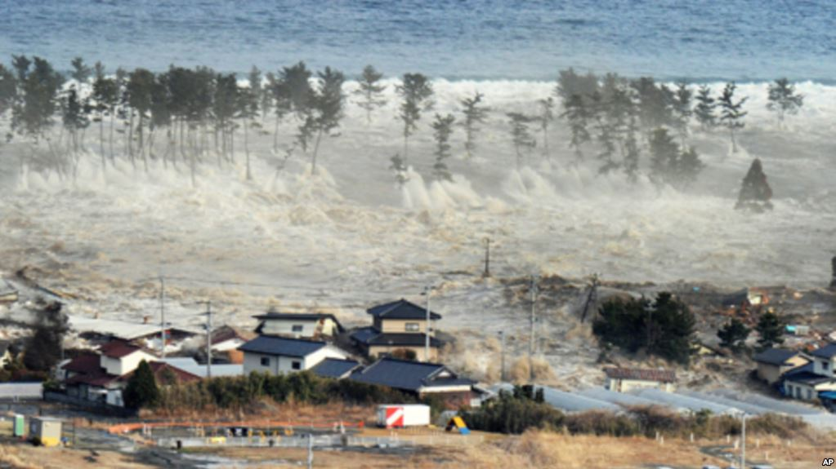


Tsunami Safety &
Preparedness
Dr. Summer Ohlendorf
U.S. National Tsunami Warning Center
Palmer, AK
Earthscope ANGLE 2022
Notes:
Photo credit: AP/Kyodo News

Slide 2
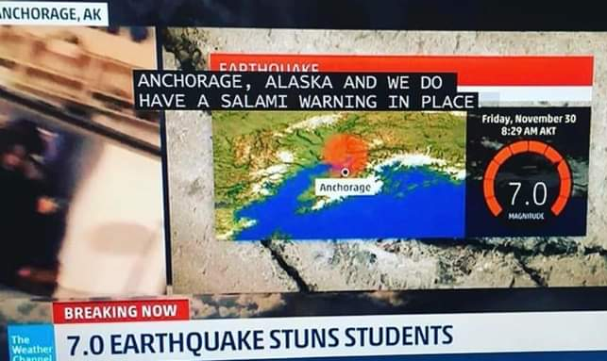


Overview
Tsunami Features
What are these waves actually like?
What to expect during a tsunami
What kind of danger and damage might there be?
Alerting
What are the different alert levels?
How does a tsunami warning work?
Evacuation
What do I need to consider?
Preparation
What can I do now?
www.tsunami.gov

Slide 3
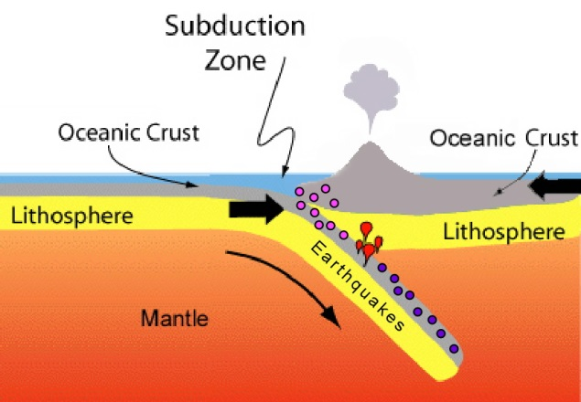
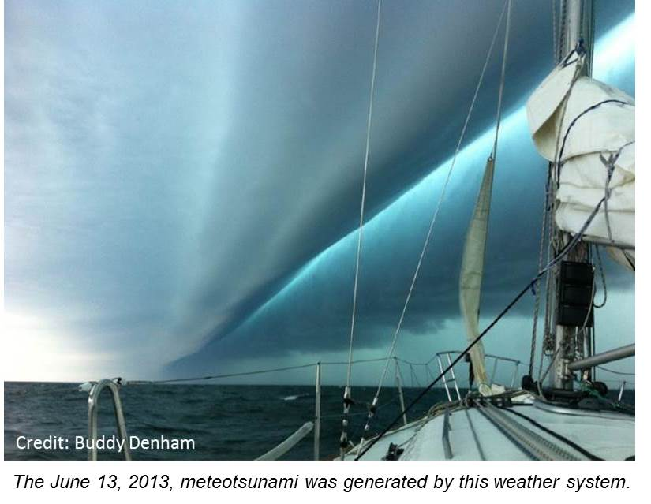
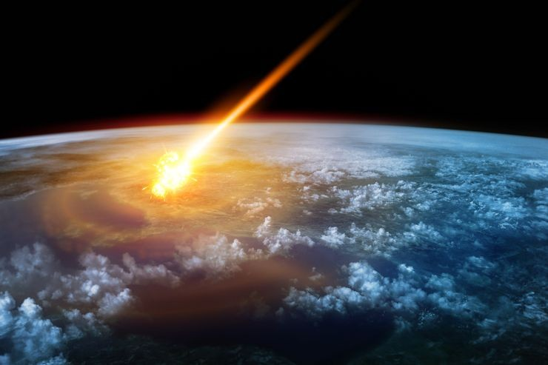
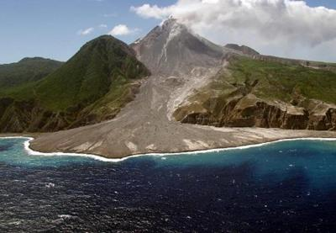
Possible sources of tsunamis
Earthquakes
Meteotsunami
Landslides
Impact
Volcanic
Processes
www.tsunami.gov
Notes:
Sudden, large displacement of water. Volcano pic: Soufriere Hills, Montserrat 2010.
Landslides: Triggered by earthquake shaking, or not. Can occur above or below water. Little to no warning
Volcano tsunami sources: Flank collapse, Submarine explosion, Pyroclastic flows
Meteo: fast-moving weather systems
Crunch more stats here: https://www.ngdc.noaa.gov/hazard/tsu.shtml

Slide 4
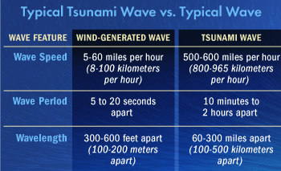
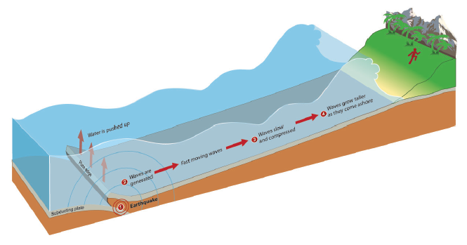
What makes a tsunami different from
other waves?
- Moves whole water column instead of just the surface
- Much longer and consists of a lot more water total
NOT “tidal waves”
www.tsunami.gov
Notes:
Slows and grows in height as it nears the shore.

Slide 5
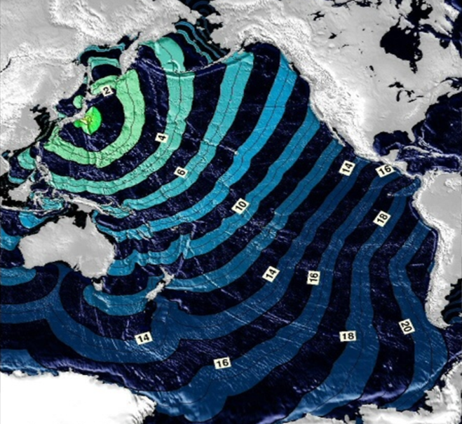


What makes a tsunami different from other waves?
Series: not a single wave ~10 min -1 hr apart.
May continue for many hours
First wave might not be biggest
Speed is dependent on water depth
  Deep ocean: ~500 mph
  Near shore: ~30 mph
www.tsunami.gov
Notes:
May continue coming in and going out for many hours, even over a day.

Slide 6
Distant vs. local tsunamis
Distance of tsunami source from your area:
Distant tsunami
Regional tsunami
Local tsunami
1000s of miles
100s of miles
10s of miles
  “Teletsunami”
  Far away earthquake: you won’t feel it!
  Likely smaller tsunami/
  Flooding limited to coast
  Potentially impacting many locations
  Hours of warning time
  Very survivable
  You may feel shaking, or hear or see a landslide or eruption
  Likely taller tsunami/
  Flooding farther inland
  More localized
  Little warning time
  Survivability based on evacuation
www.tsunami.gov
Notes:
Distant vs. local is a continuum!
At a particular location, will face distant tsunamis more often, but local tsunamis are much more likely to be severe.

Slide 7
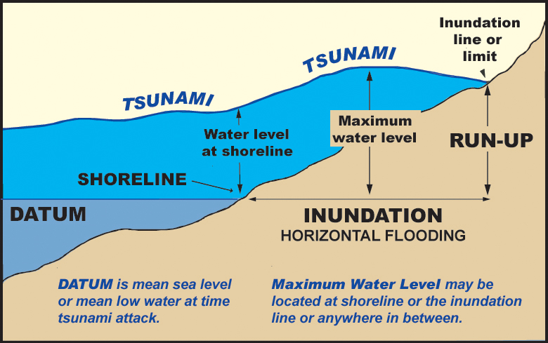
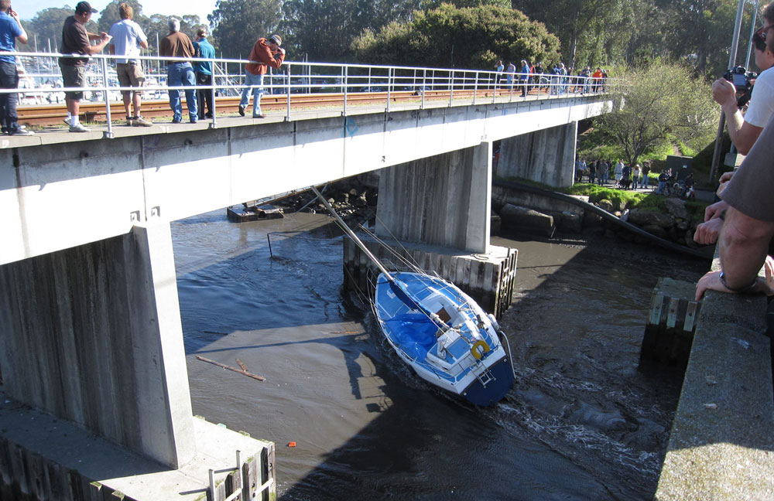
Hazards associated with tsunamis
Coastal flooding/ inundation
-Tsunamis can also travel up low-lying coastal waterways
- Tsunami arrival at high tide will be worse than low tide
- Subsidence during earthquake will also result in more inundation
Santa Cruz Harbor, 2011: 13 knot current
Strong Currents
Danger from even “small” or distant source tsunamis
www.tsunami.gov
Notes:
Tsunamis can bring both dangerous currents and coastal flooding. Bottom: Santa Cruz, CA after 2011 Japan tsunami (1.9 m max amplitude run-up, 13 knot/7m/s current, $28 million damage). 1960 Chile: 8 knot current L.A., 10 knot current Japan
In Japan 2011 Tsunami, the wave run-up heights were up to 133 feet in some places and it traveled up to 6 miles inland in some places.

Slide 8
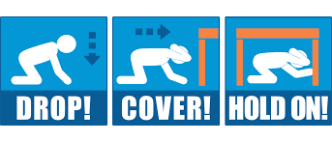
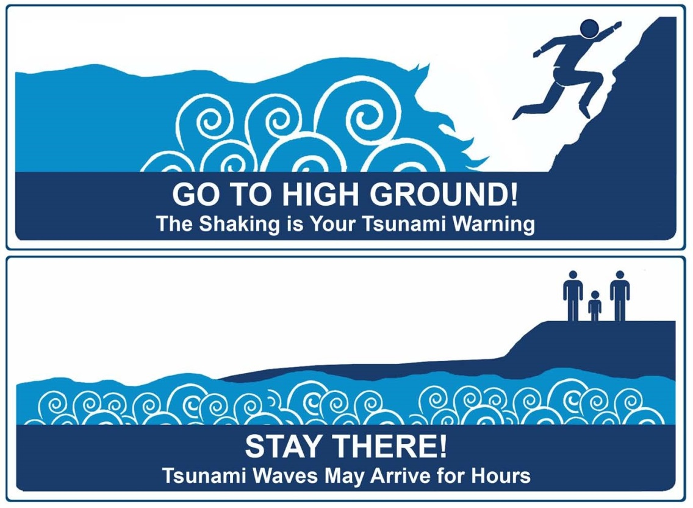
What should I do if I feel shaking?
*Alaska:
Where are you at?
Is it safer to start evacuating during the shaking?
Is it difficult to stand?
Does the shaking last longer than 20 seconds?
www.tsunami.gov
Notes:
This is the “standard” advice. If you’re in an Alaskan fjord, you may not have the luxury of waiting for shaking to stop in order to start evacuating.

Slide 9
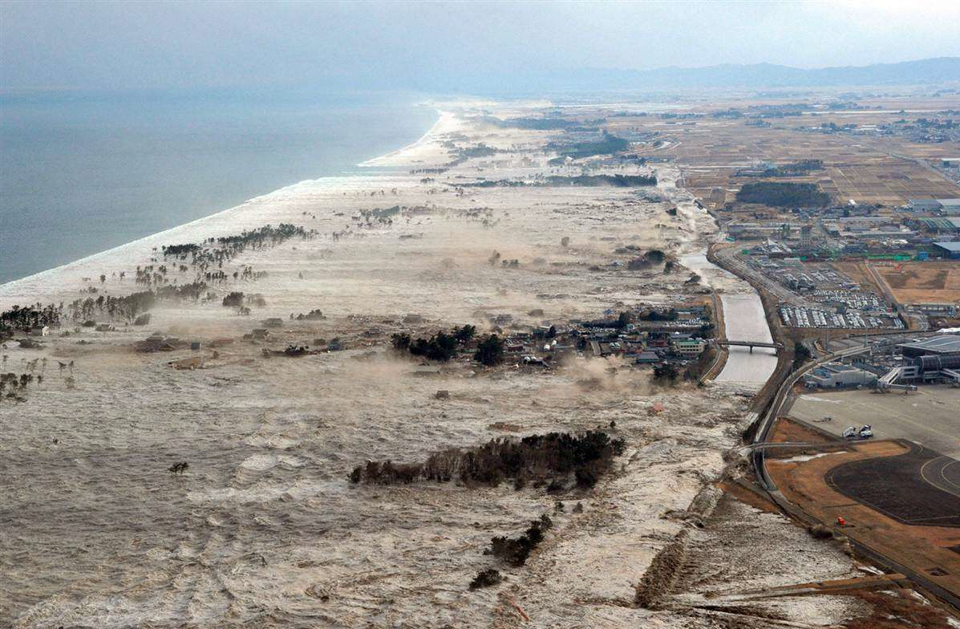
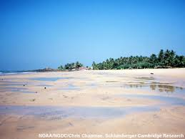
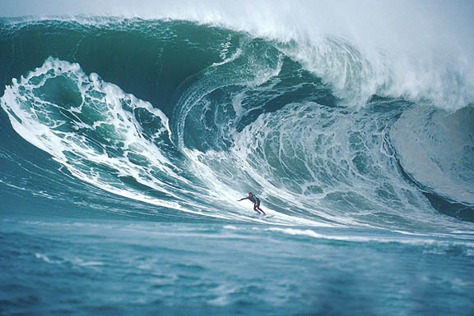

Natural signs of a tsunami
Strange ocean behavior
    Wall of water or fast flooding
    Strong currents
    Sudden draining away of water
Strange ocean noises
  Loud roar, or gurgling
www.tsunami.gov
Notes:
Japanese woodblock print. Not often a breaking wave

Slide 10

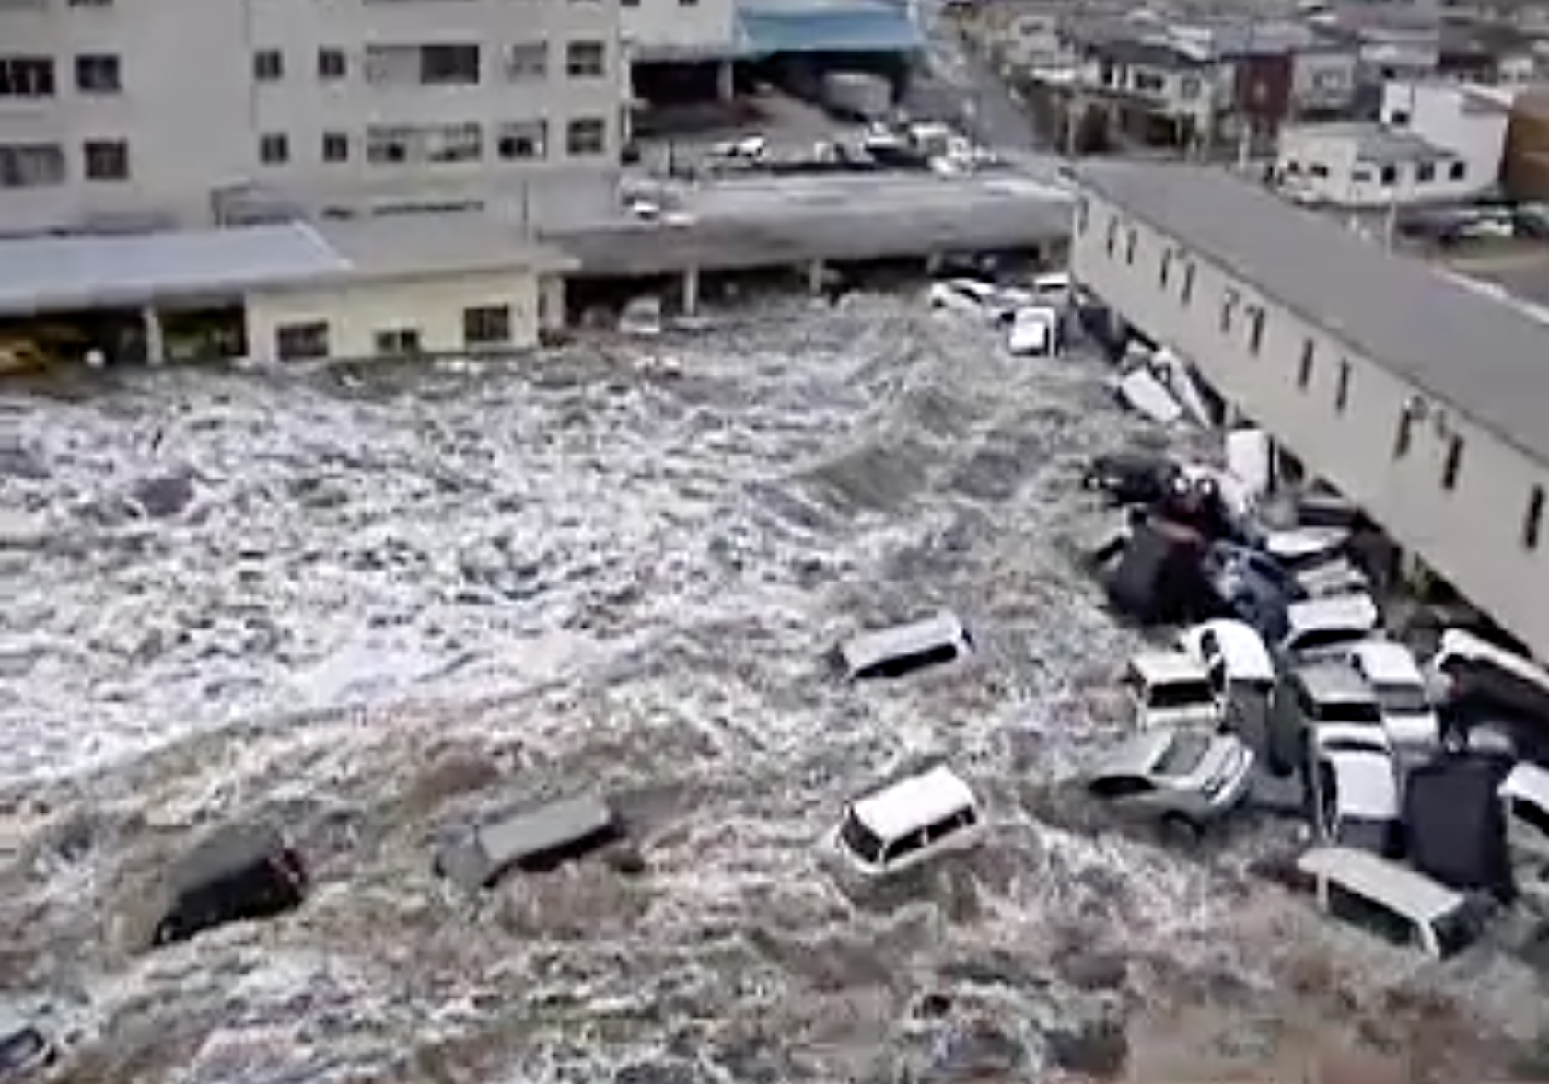
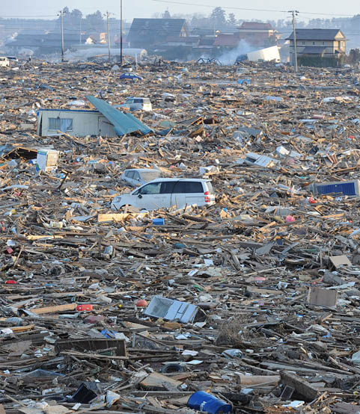
What to expect: debris-filled turbulent water
Potential to get pinned against objects or pulled underwater
Jagged, moving debris
www.tsunami.gov
Notes:
Fast flowing, debris-laden river
Objects become battering rams
Erodes, scours, deposits mud
The waves and surges come in and go out, in and out, scouring away at structures and landscape, etc…carrying debris and hazardous materials with each wave/surge.
How will we get through the debris to move to other areas or find loved-ones without injuring ourselves?
What will we do with the debris? How will we move it?

Slide 11
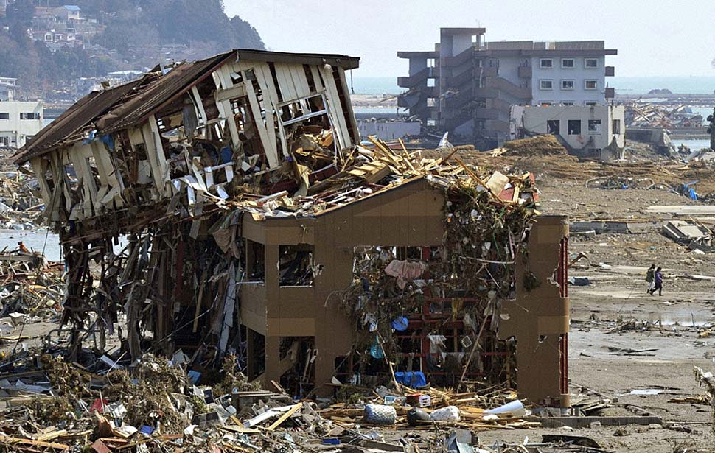
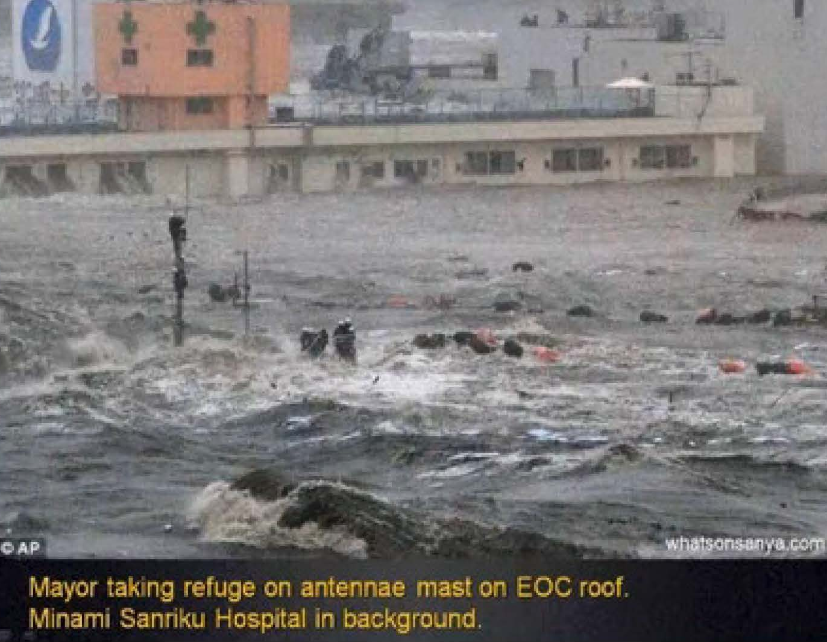
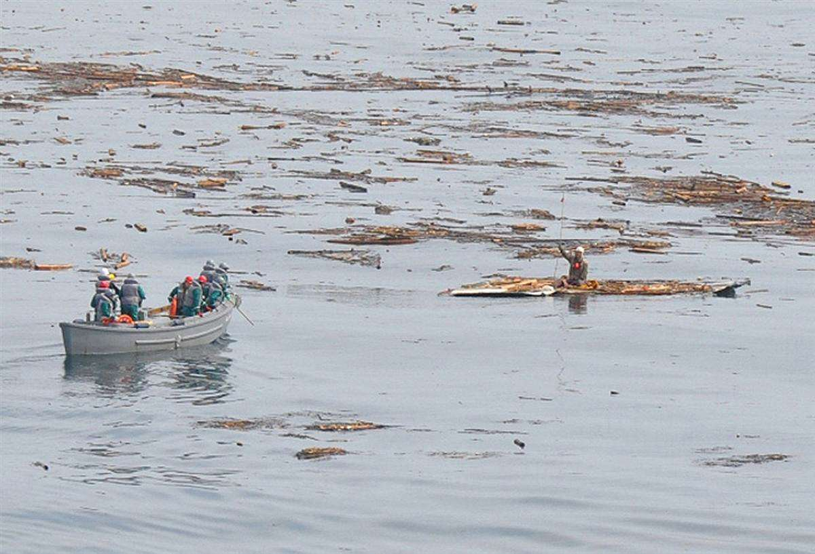
What to expect: infrastructure destroyed
Difficulty obtaining food and fresh water
Lack of power
Lack of shelter
www.tsunami.gov
Notes:
Might be stuck there for many hours, or even need to wait for rescue.

Slide 12
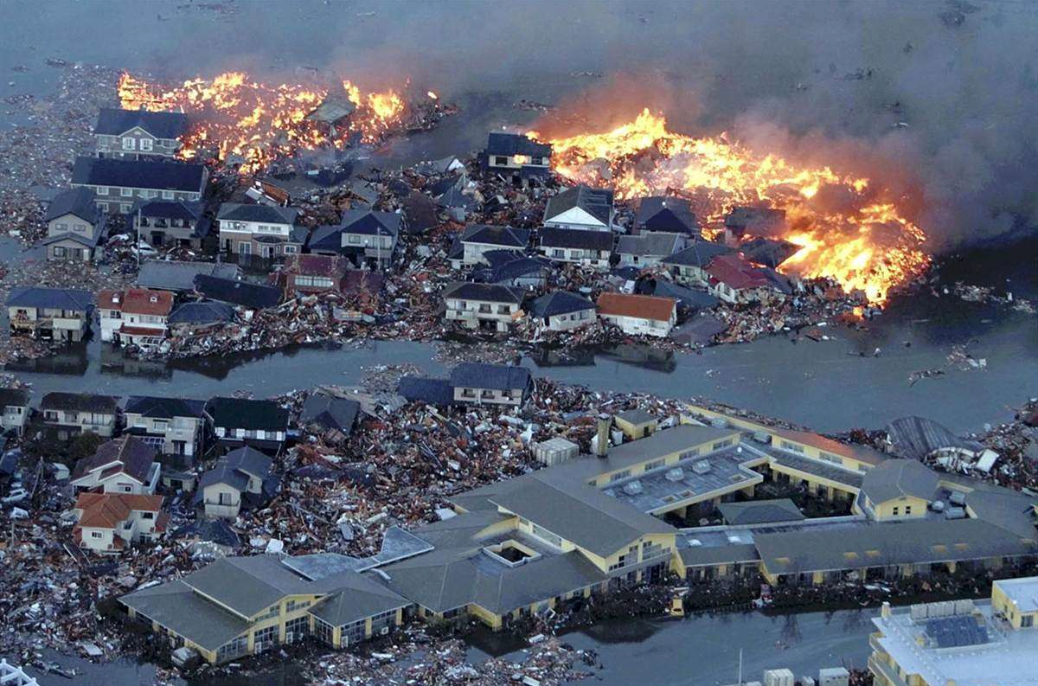
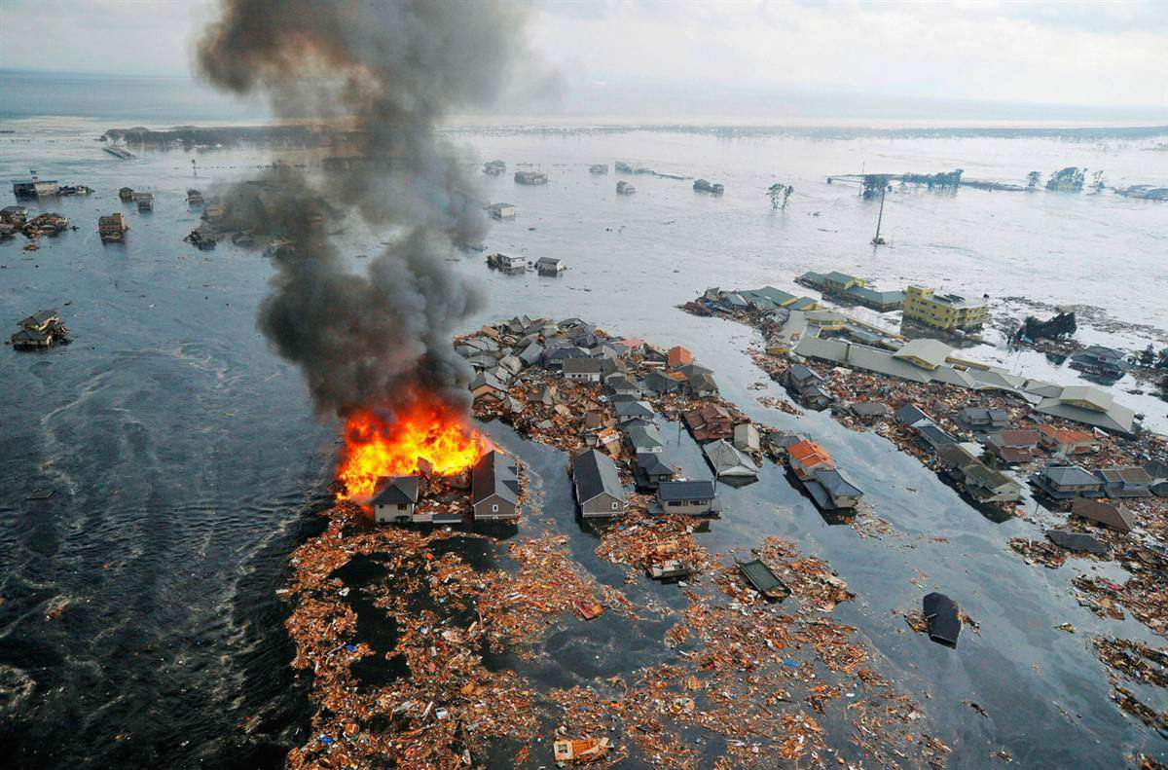
What to expect: fires
Gas lines broken, tanks rupture
1964: Seward faced fire from burning oil tanks
Tsunami surges contribute to spreading fire
www.tsunami.gov

Slide 13
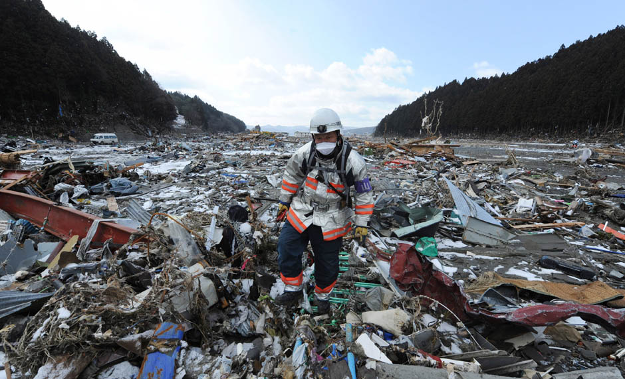
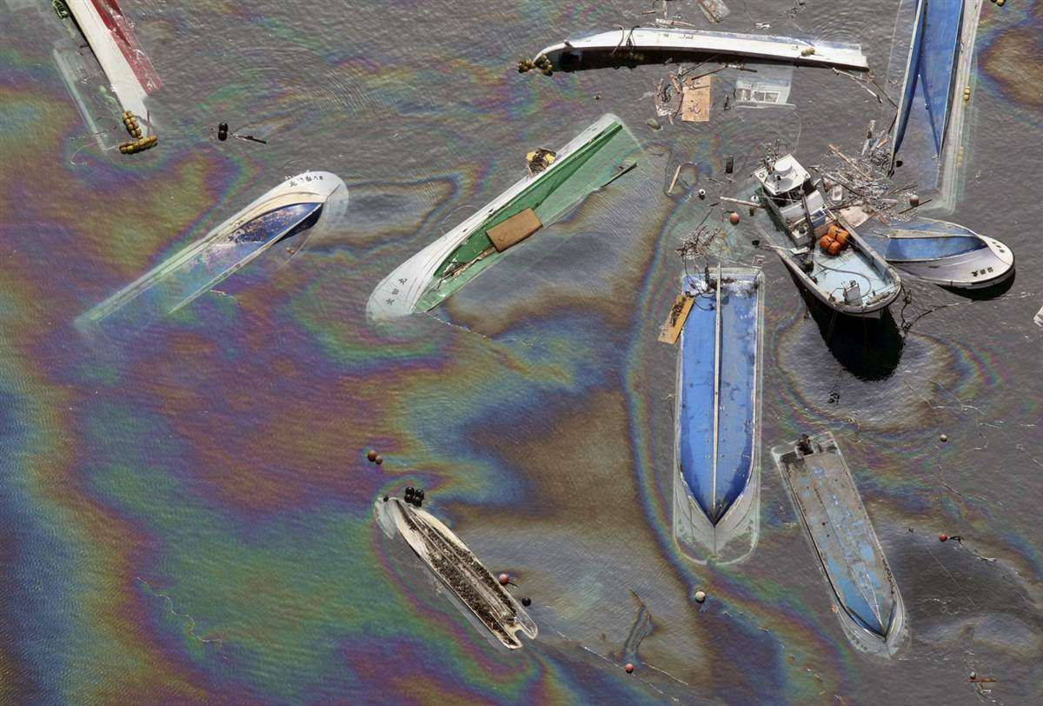
What to expect: hazardous materials
Impacts to subsistence, agriculture, and fishing industry
Extended cleanup and remediation process
www.tsunami.gov
Notes:
Household and industrial chemicals. Oil industry infrastructure.

Slide 14
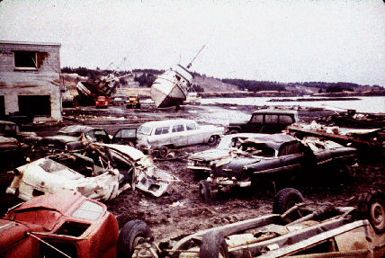
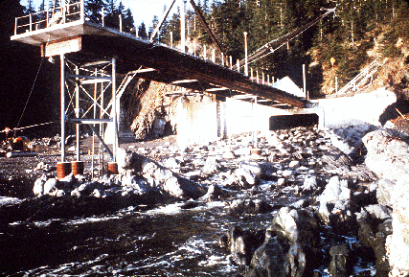
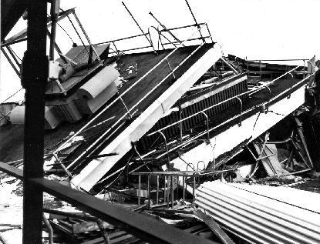
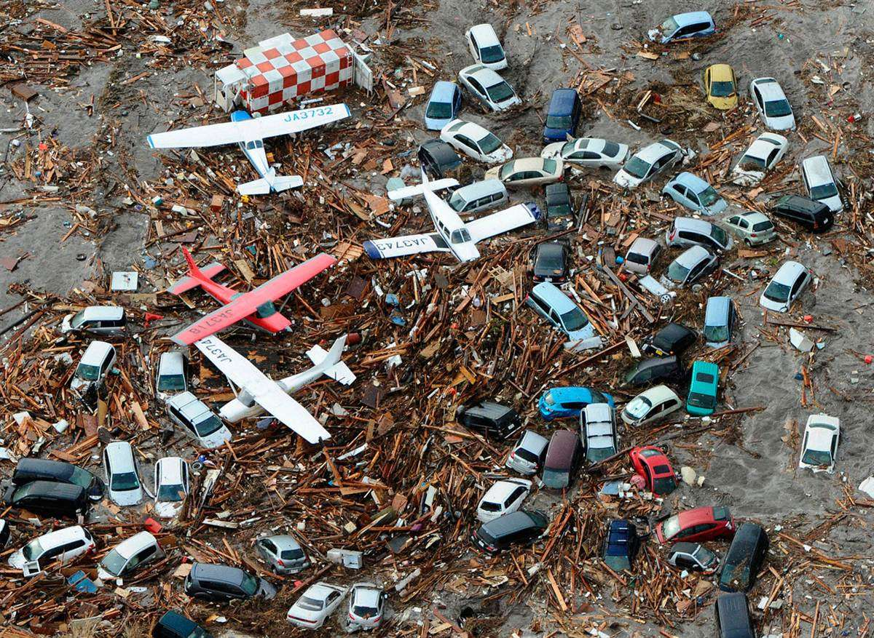
What to expect: travel, shipping severely disrupted
Photo: USGS
Photo: USGS
Photo: USGS
Airports may not be functional
Ports and harbors are prone to the greatest damage
www.tsunami.gov
Notes:
Think about where you get your groceries! Your gas! How many things come through Alaska’s ports?
Top left: Kodiak, top middle: Hinchinbrook Island in PWS, top right: Control Tower of the Anchorage Airport (all from 1964)
Bottom right is probably Tohoku Japan, 2011.

Slide 15
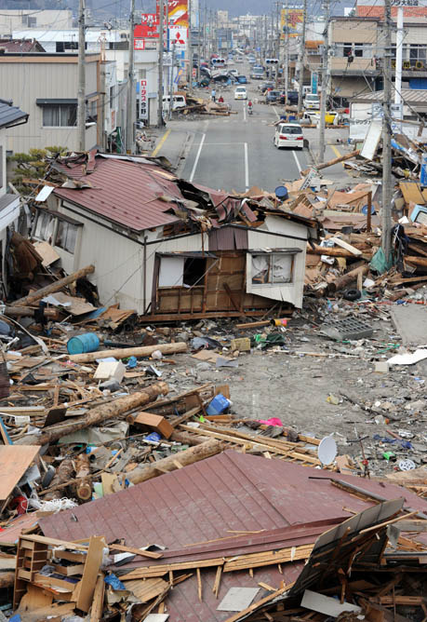
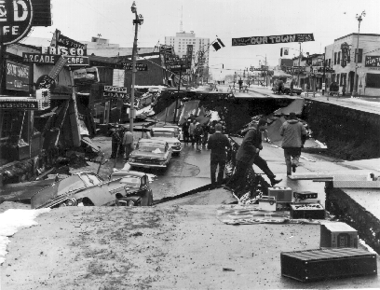
What to expect:
travel, shipping severely disrupted
Roads, highways, and bridges may be damaged or blocked, and impassable
Photo: USGS
www.tsunami.gov
Notes:
How many big areas of the state are connected by a single road?

Slide 16
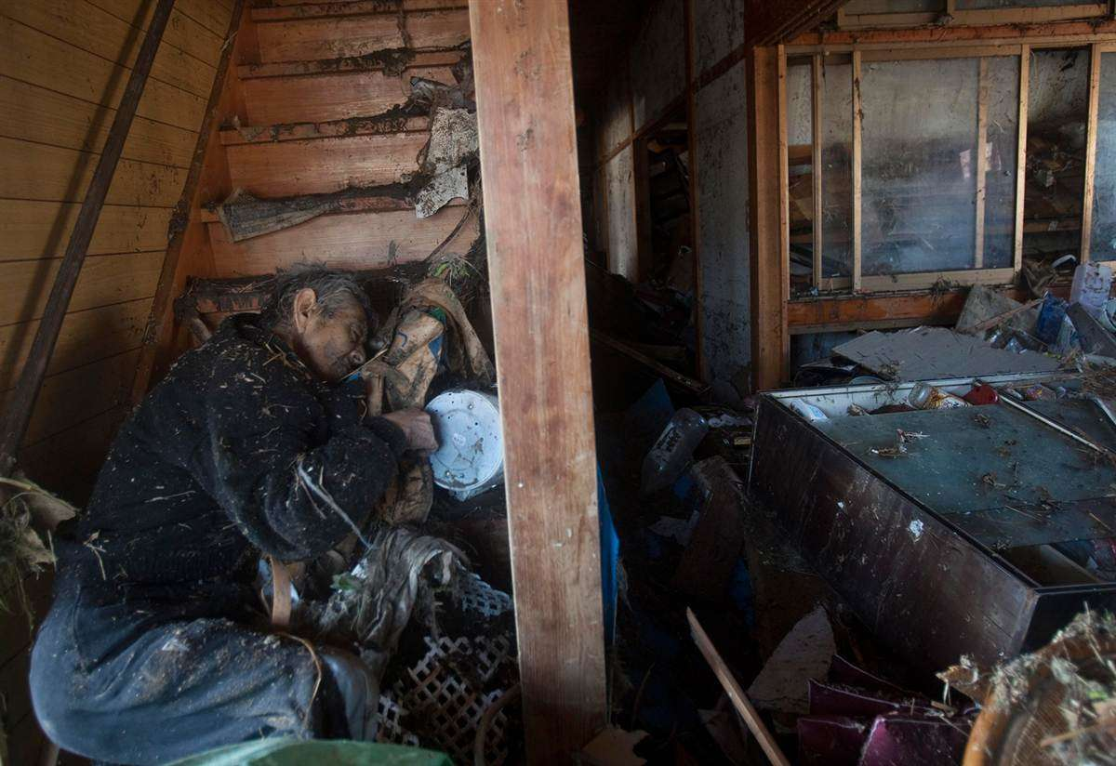
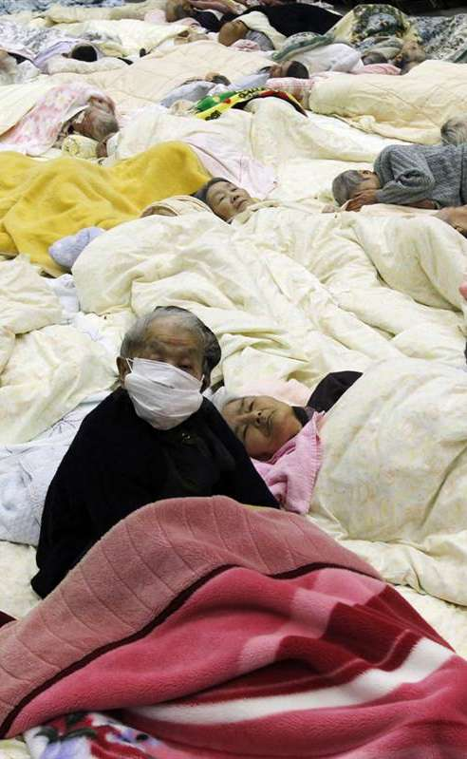
What to expect: injuries & death
1964 earthquake: 9 lives, tsunami: 122
Expect damaged and crowded, or makeshift care facilities
Difficulty replenishing supplies
www.tsunami.gov
Notes:
There will be injuries, but probably more deaths from the local tsunami.

Slide 17
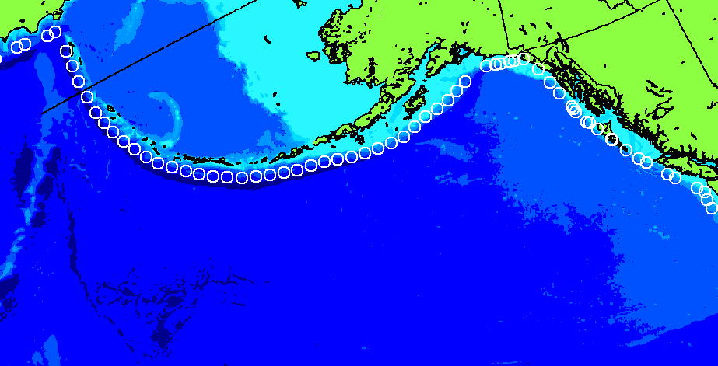
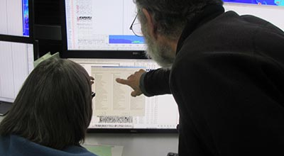
How do we warn people?
Initial alert level based on:
                Earthquake magnitude
                Earthquake depth (deeper ->
                less surface displacement)
  Location: distance from shore
Later refined alert levels based on:
  Adjustments to magnitude
  Sea level measurements (DART, tide gauges)
  Forecasts
Tsunami model source locations
www.tsunami.gov
Notes:
Faulting mechanism, water depth, tidal stage not explicitly considered for first message
We adopt the official magnitude of the USGS when it comes out (usually after 20-30 mins)

Slide 18
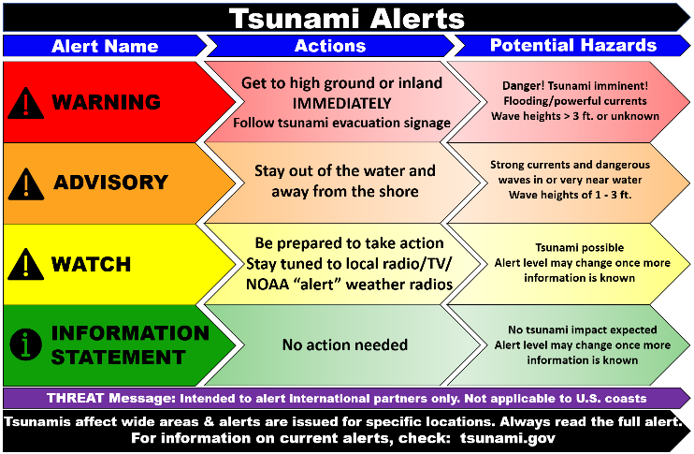
Tsunami Alert Messages
PTWC
only
www.tsunami.gov
Notes:
NTWC’s sister center, the Pacific Tsunami Warning Center, issues “threat messages” for the international Pacific and Caribbean. These may show up on our joint website (tsunami.gov) but Alaska does not need to worry about them.

Slide 19
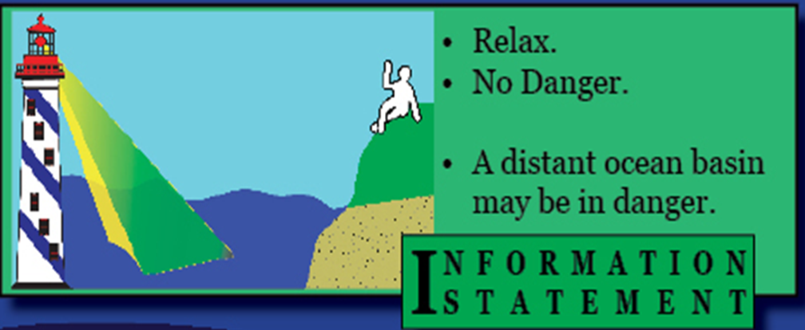
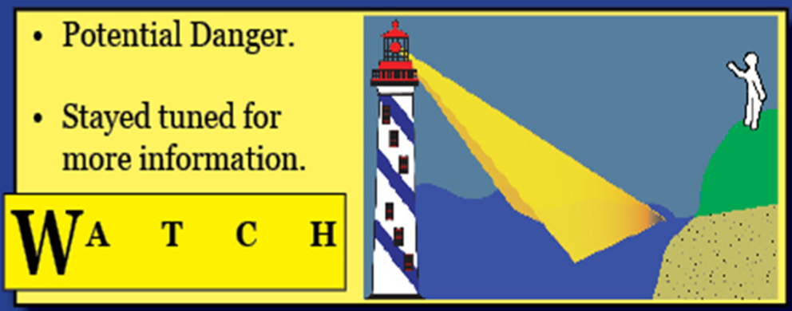
Tsunami Alert Messages
wave height <0.3 m
Small coastal earthquake
or
Distant earthquake that
won’t pose a threat to U.S.
temporary status
assessing threat
www.tsunami.gov
Notes:
Watch: sometimes used for distant earthquake, unusual area. Would be upgraded or cancelled hours ahead of the hypothetical tsunami arrival time.

Slide 20
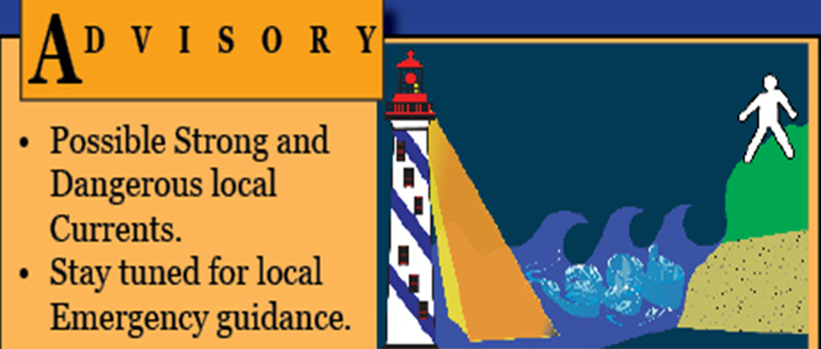
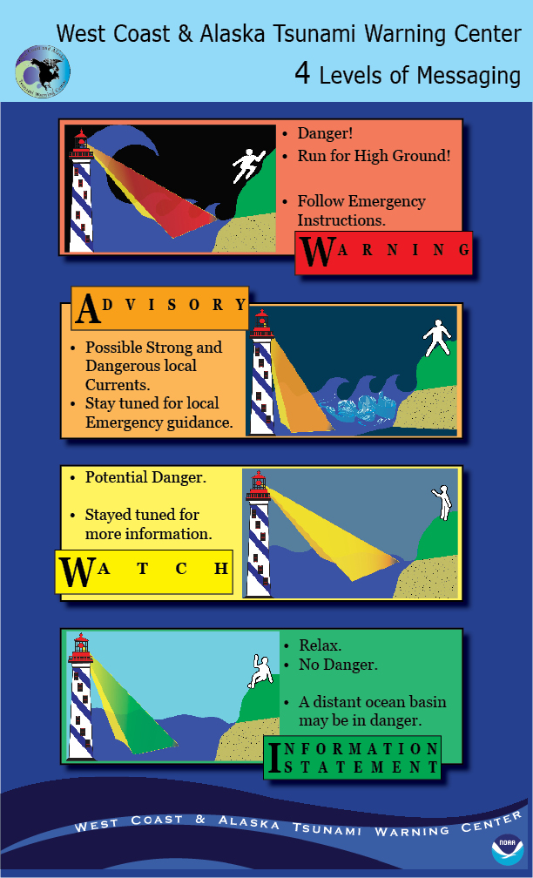
Tsunami Alert Messages
Expected
wave height
Example impact
1964, 0.6 m tsunami: $200k damage in L.A. harbor
0.3m-1m
1964, 1.2 m tsunami: $500k damage in Seldovia
1m+
www.tsunami.gov
Notes:
Advisory: stay away from beaches, harbors, coastal waterways. May be local flooding.
Warning: evacuate to higher ground or inland

Slide 21


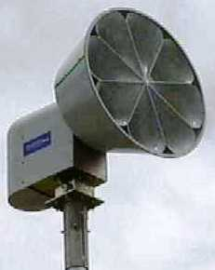
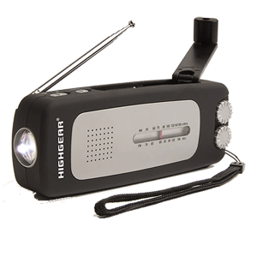
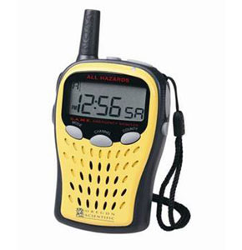
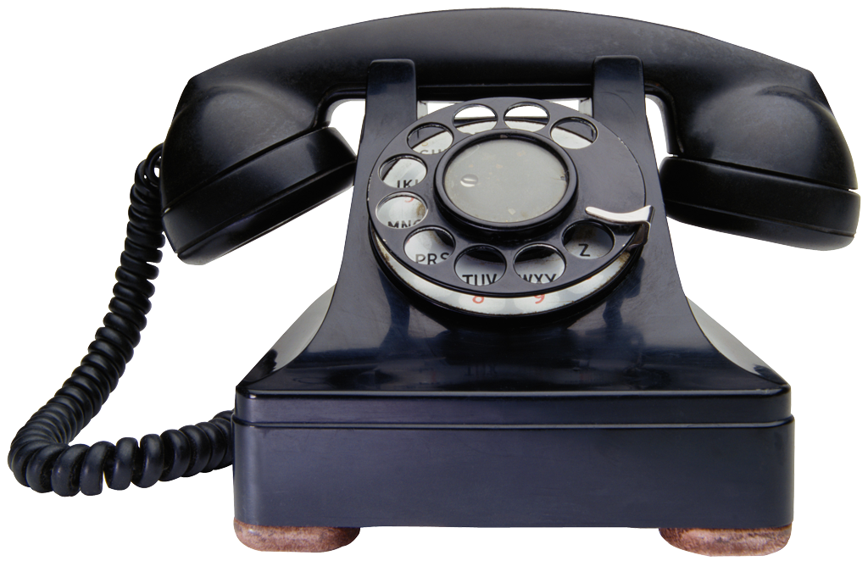
How can I find out about a tsunami?
Emergency Alert
System (EAS)
Wireless Emergency
Alert (WEA)
Community alerting
Beach
Sirens
Tsunami Warning
NOAA Weather Radio
Reverse 911
TV
Radio
Individual alerting
Apps (Nixle, etc.)
Push notification
www.tsunami.gov
Notes:
Sirens: can also be local police/fire
Email/SMS signup: tsunami.gov. Can receive our tweets by SMS if have Twitter account

Slide 22
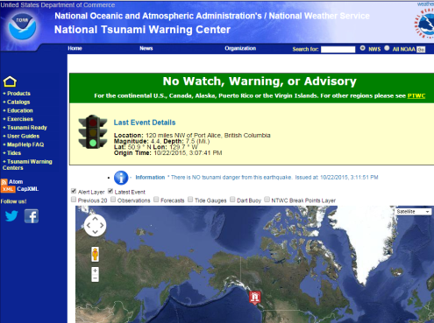

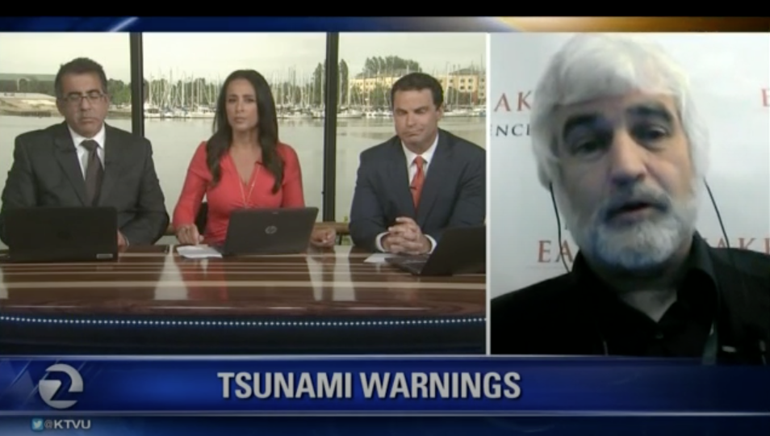
Where should I go for more info?
Tsunami
Warning
Center
Tsunami.gov
State
Emergency Mgmt.
Local
Emergency Mgmt.
Local NWS office
Media
Anchorage
Juneau
Fairbanks
ADHS&EM
www.tsunami.gov

Slide 23
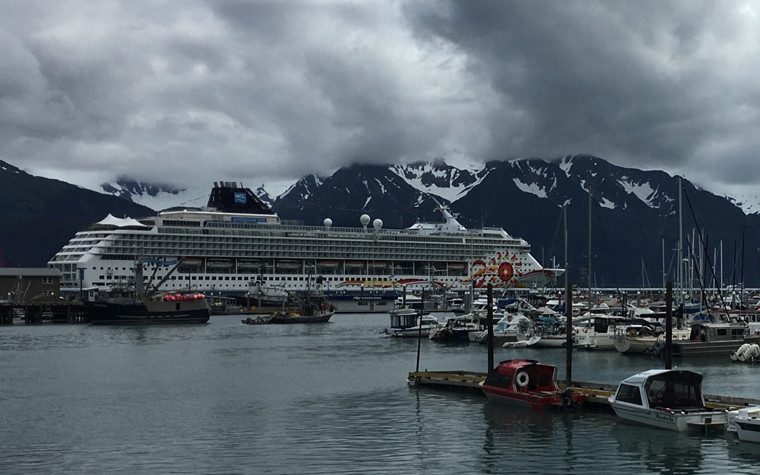
Considerations: how to evacuate
Where are you?
How much time do you have?
Earthquake damage:
  Debris, downed power lines
TRAFFIC
      How many different routes are there to safe locations? Are there bottlenecks?
Seasonal crowds: will likely not have emergency supplies, may not know what to do
    Do you know for sure that your shelter location is stocked with supplies? For how long, for how many people?
Images from Pixabay
www.tsunami.gov

Slide 24
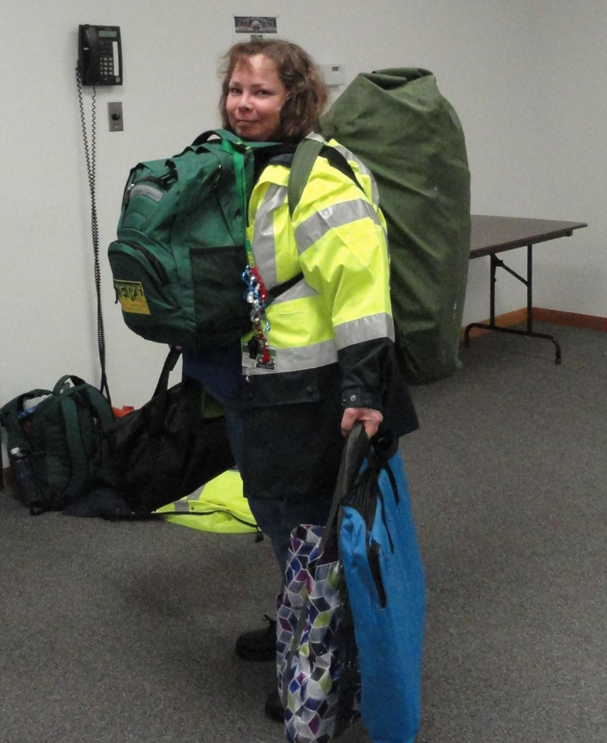
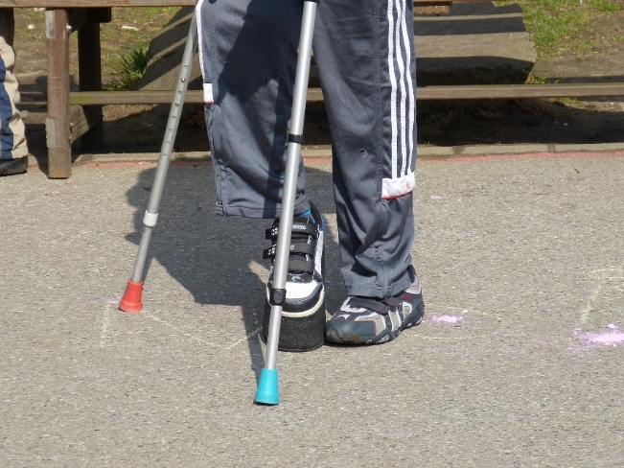
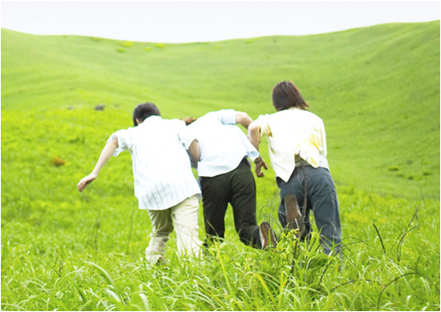

Considerations: what to take?
Situation
Ability
Distance
Time
Weather
Obstructions
Mobility restrictions
Carrying capacity
Ability to gather
Transportation speed
www.tsunami.gov
Notes:
Practice assessing your situation, you can also practice carrying emergency supplies
You may or may not want to bring supplies – class discussion (pros and cons)
Consider storing them in advance at a friends house on high ground.
If stopping to go and retrieve your supplies is going to cost your life, don’t do it. You’ve got to escape the tsunami before you can start thinking about those supplies you need to meet your basic needs. First things first.

Slide 25


How do I know when it’s safe?
1. Cancellation Message from TWC
2. *Wait for official all-clear from local officials*
3. Re-enter with caution!
4. Clean up
www.tsunami.gov
Notes:
Cancellation Message: Wait for cancellation message (from National Weather Service)
Re-enter with caution: Local emergency service officials may provide specific re-entry instructions based on damage to certain areas/infrastructure.
Damage: Possible damage in harbors, near beaches and other low-lying areas. Some roads may be impassible, temporarily, there may be hazardous materials, fires, or other hazards involved.
Clean up: There may be Clean up that is necessary.

Slide 26

What can I do to prepare?
Learn your risk
Is your home, work, etc. in a potential tsunami inundation area?
Where are the designated evacuation routes?
How far might you need to travel?
No map or signs? Get at least:
1 mile inland
100 ft above sea level
3 stories up in a sturdy building
AK inundation maps: tsunami.alaska.edu
www.tsunami.gov
Notes:
Evacuation routes, 100 ft asl or 2 mi inland. Coordinate with family. Make a portable kit of essentials
We need to prepare for the worst so we will be ready for any size event.

Slide 27



What can I do to prepare?
Make a plan!
  Where to go and how to get there
  What to take
  Food, including pet. Water or filter. Warm clothes.
  How to communicate
How will you meet up with family if separated?
How long will batteries last?
AK evacuation maps: www.ready.alaska.gov
www.tsunami.gov
Notes:
Cell phone towers may be overloaded, or down completely

Slide 28




Plan Ahead – Be Aware
Signs
Evacuation Routes
Safe Areas
  Temporary Assembly Areas
  Vertical Evacuation Options
Kodiak
www.tsunami.gov
Notes:
Know if you’re in the Tsunami Zone WHETHER YOU’RE AT HOME, SCHOOL, WORK, GROCERY STORE, CHURCH, PARK, etc.
Know where “high ground” is (options in case primary route is blocked) even when you’re driving.
Practice walking to high ground
Does your school, park, or business have a plan for a Distant Tsunami?

Slide 29

Practice!
Go On Foot
Assist Others
Consider Options
www.tsunami.gov
Notes:
Practice from different locations
Make a game of it…where would we go right now if we felt an earthquake?
Don’t forget pets.
Go on foot. Walk or run. Roads will probably be impassible. Some may try to ride a bike… (Time yourself)
Practice evacuating with those needing assistance: children, elderly, those with mobility challenges, pets, etc.
Consider options for routes & assembly areas. Try different routes and assembly areas.

Slide 30

Practice!
Participate in drills– can also create your own!
Easy to tack on to earthquake drills, e.g. ShakeOut (Oct. 20)
Think through different scenarios
Consider involvement with CERT
Alaska Tsunami Preparedness Week:
end of March
www.tsunami.gov
Notes:
CERT= Community Emergency Response Team

Slide 31


TsunamiReady Program
Goal: improve safety before, during & after tsunami emergencies by establishing guidelines for a standard level of capability of communities to mitigate, prepare for & respond to tsunamis
What it is:
- Access to expert advice & technical support from the National Tsunami Hazard Mitigation Program
- Eligibility for credit from FEMA's Community Rating System, which provides discounts on insurance
- Way to also improve preparedness for other hazards
www.tsunami.gov
Notes:
https://www.weather.gov/tsunamiready/

Slide 32
How does a community become
TsunamiReady?
  Defining tsunami hazard zones, producing evacuation maps, & installing evacuation route signs
  Supporting ongoing, sustained tsunami public education and outreach, including to schools in tsunami hazard zones
  Establishing a 24-hour warning point & emergency operations center
  Having more than one way to receive tsunami alerts and to warn the public
  Developing a formal tsunami operations plan & holding annual exercises
www.tsunami.gov
Notes:
https://www.weather.gov/tsunamiready/guidelines

Slide 33



Further Resources
U.S. Tsunami Warning Centers
www.tsunami.gov
Alaska tsunami hazard level by community, and tsunami evacuation maps: https://www.ready.alaska.gov/
Alaska tsunami inundation maps:
https://earthquake.alaska.edu/tsunami/community
Alaska Volcano Observatory
https://www.avo.alaska.edu/
NOAA NCEI searchable tsunami database:
https://www.ngdc.noaa.gov/hazard/tsu.shtml
National Tsunami Hazard Mitigation Program
https://nws.weather.gov/nthmp/
NWS TsunamiReady program
https://www.weather.gov/tsunamiready/
Tsunami Zone
https://www.tsunamizone.org/
www.tsunami.gov
Notes:
Also: USGS Professional Paper series on the effects of the 1964 earthquake on Alaskan communities
Want to set up a tour of NTWC? Call our office: 907-745-4212.
Contact Summer to discuss any other outreach ideas: summer.ohlendorf@noaa.gov

Slide 34
Supplemental Slides

Slide 35
Tsunami impact at various wave heights
Wave Height (m) | Location and Damage | Year
0.5 | Crescent City, CA; 1 mooring broke loose | 1963
0.5+ | San Diego, CA; boat/dock damage | 1957
0.51 | Adak, AK; no damage | 1996
0.55 | Port Orford, OR; no damage | 2006
0.6 | Arena Cove, CA; no damage | 2006
0.6 | Port San Luis, CA; no damage | 2006
0.6 | Ketchikan, AK; no damage | 1964
0.6 | LA, CA; $200K damage to boats | 1964
www.tsunami.gov
Notes:
1964 0.6m comparison
Data from NOAA NCEI (Nat. Centers for Environmental Information)

Slide 36
Tsunami impact at various wave heights
Wave Height (m) | Location and Damage | Year
0.8+ | Los Angeles, CA; $1 million damage, 1 drowning | 1960
1-1.5 | San Francisco Bay, CA; $1 million damage | 1964
1.2 | Seldovia, AK; $500K damage to boats | 1964
1.4 | Ilwaco, WA; streets flooded | 1964
2.2 | Half Moon Bay, CA; 3 near drownings, flooding, boat damage | 1960
4.8 | Crescent City, CA; 10 dead, $15 million damage | 1964
Supplemental Slides
www.tsunami.gov

