Slide 1
Simple Machines Pulley By: Megan

Slide 2
What is a simple machine?
They are machines with few or no moving parts that make work easier to do.

Slide 3
What is a Pulley?
A pulley makes lifting heavy weights easier by redirecting force.

Slide 4
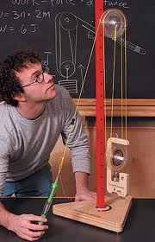
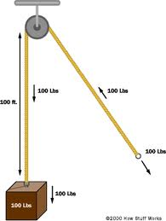
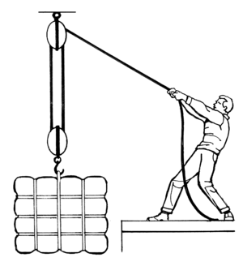
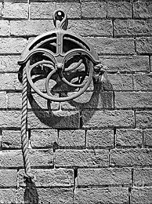
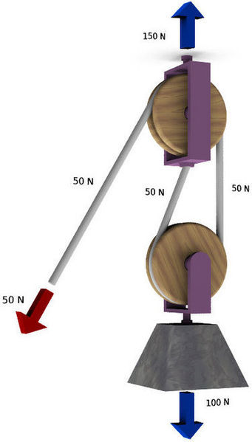
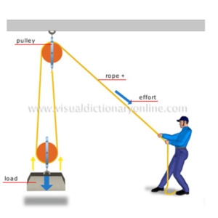
Examples of a pulley.
Some pulleys look like these.

