Slide 1
Simple Machines wheel and axle By: Maryssa

Slide 2
What is a Simple Machines?
There is a reason why they are called Simple Machines because they are Simple too use it is not hard to make Simple Machines. I mean you could make a Simple Machines with just a block of wood you could make it in to a wedge there is six different Simple Machines well they are not too much different from each other they can be similar to each other so now you know Simple Machines can be fun in a way some people can not imagine it makes work easier.

Slide 3
What is a Wheel and Axle
A Wheel and Axle is a Simple Machine but it can be many more things and if we did not have Wheel and Axle then we would not have cars or Wheel baral then we could not get heavy things too places and plans because then planes would not be able too land and a drivers Wheel there are lots of different things for Wheel and Axle.

Slide 4
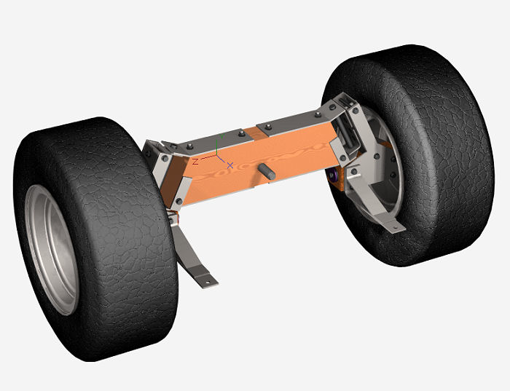
example of Wheel and Axle

