Slide 1
Alaska Earthquakes & Tsunami
ANGLE Project
https://serc.carleton.edu/ANGLE

Slide 2
Great (M > 8) Alaska Earthquakes
In 27 years from 1938 to 1965, a series of great earthquakes ruptured almost the entire length of the subduction zone.
How often do great earthquakes occur in eastern portion?
Notes:
From IRIS Animation Alaska: Tectonics and Earthquakes
https://www.iris.edu/hq/inclass/animation/alaska_tectonics_and_earthquakes

Slide 3
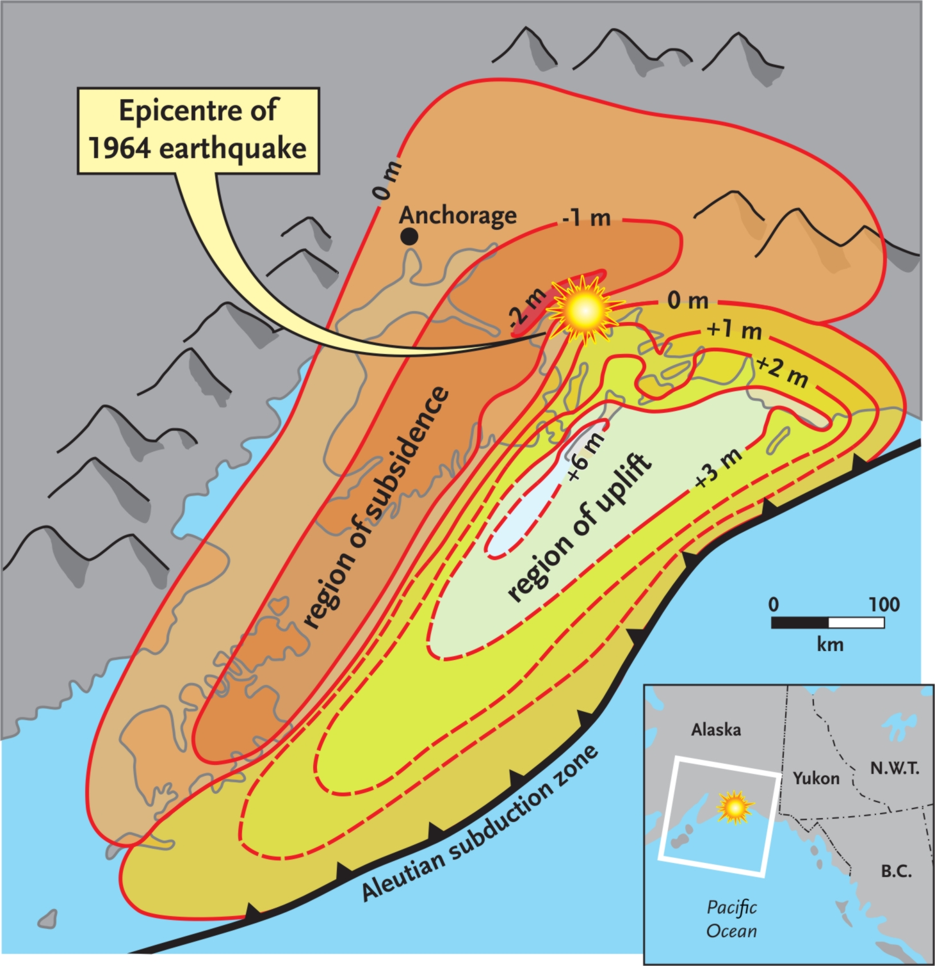
Land Level Changes During 1964 Alaska Earthquake
Areas in the uplift zone were raised as much as 6 meters while areas in the subsidence zone dropped by more than 2 meters.
Pacific Plate
Notes:
Illustration used with permission from: “At Risk: Earthquakes & Tsunamis on the West Coast" by J. Clague, C. Yorath, R. Franklin, and B. Turner, Tricouni Press, 200 pp., 2006.

Slide 4
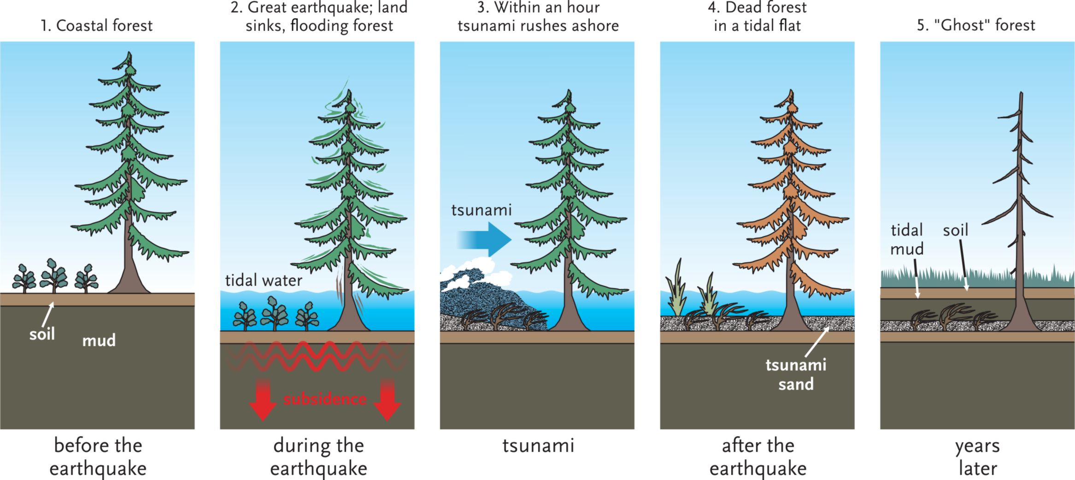
Making a Ghost Forest
1. Coastal forest above high tide before earthquake.
2. Earthquake drops forest into intertidal zone.
3. Tsunami rushes ashore depositing sand on soil layer.
4. Trees die from immersion in salt water.
5. Intertidal mud & clay deposited above tsunami sand.
“Three layer cake” = buried soil, tsunami sand, intertidal mud.
What layer did we NOT see at Girdwood? Why?
Notes:
Illustration used with permission from: “At Risk: Earthquakes & Tsunamis on the West Coast" by J. Clague, C. Yorath, R. Franklin, and B. Turner, Tricouni Press, 200 pp., 2006.

Slide 5
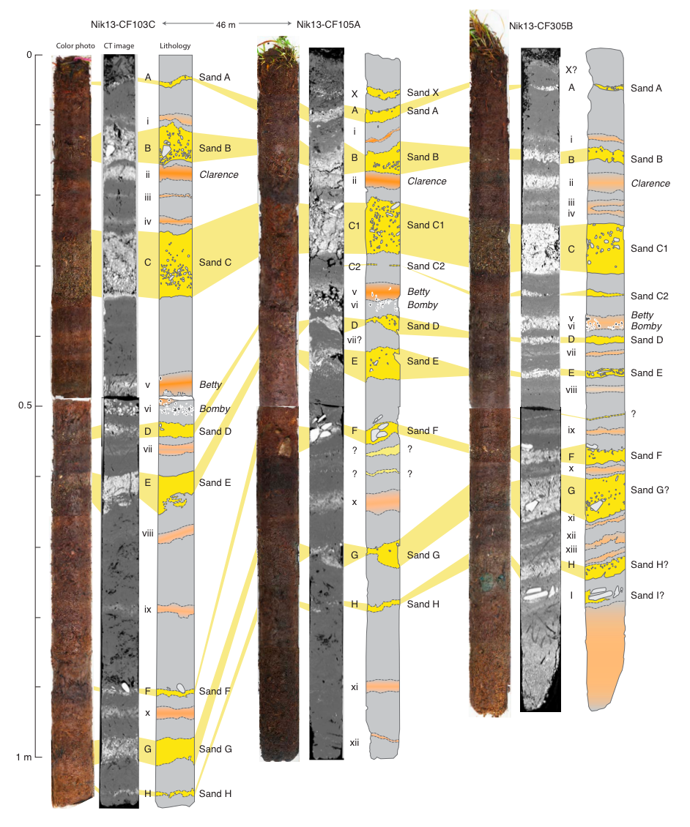
(Pre)History of Great Alaska Earthquakes
Cupcake Geology
Girdwood
Umnak Island
Average time between earthquakes = Recurrence time.
Recurrence time for M9 Earthquakes (e.g. 1964) in Prince William Sound = 700 - 900 years.
8 sand sheets in ~2200 yrs
Tsunami recurrence 280–295 yrs
Notes:
Illustrations courtesy of Rob Witter, US Geological Survey Alaska Science Center.

Slide 6
Alaska Seismicity
Since 1900:
45 M 5–6 EQs / year
6 M 6–7 EQs / year 1 M 7–8 EQs / year 8 M > 8 EQs
1 M = 9.2 EQ
Notes:
Graphic from Are You Prepared for the Next Big Earthquake in Alaska?
https://earthquake.alaska.edu/sites/default/files/are-you-prepared_Nov2016-web.pdf

Slide 7
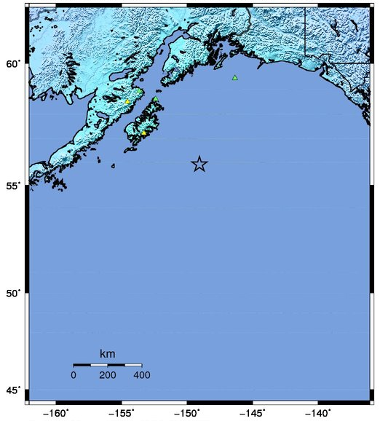
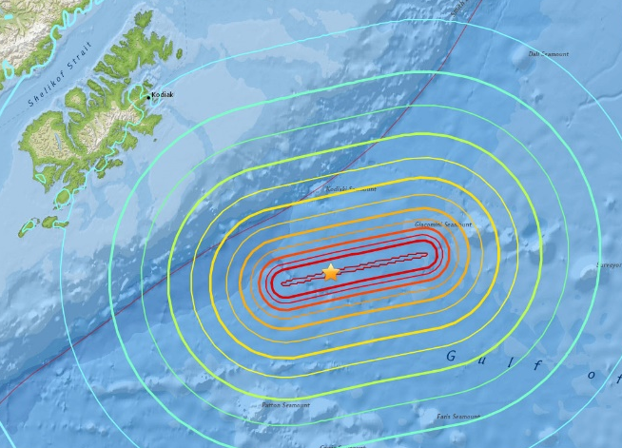
Jan 23, 2018 Magnitude 7.9 Southeast of Kodiak
Many citizens of Kodiak appropriately evacuated from the tsunami inundation zone to high ground.
Light to moderate shaking from this earthquake was felt across southern Alaska.
Left-lateral strike-slip on ENE – WSW oriented fault within the Pacific Plate.
Strike-slip faulting does not produce vertical offset of the ocean floor so does not generally produce a tsunami. BUT a small tsunami was observed.
USGS Estimated shaking intensity from M 7.9 Earthquake
Notes:
ShakeMap on left from US Geological Survey National Earthquake Information Center.
https://earthquake.usgs.gov/earthquakes/eventpage/us2000cmy3#shakemap
Isoseismal map on right from US Geological Survey National Earthquake Information Center.
https://earthquake.usgs.gov/earthquakes/eventpage/us2000cmy3#map

Slide 8
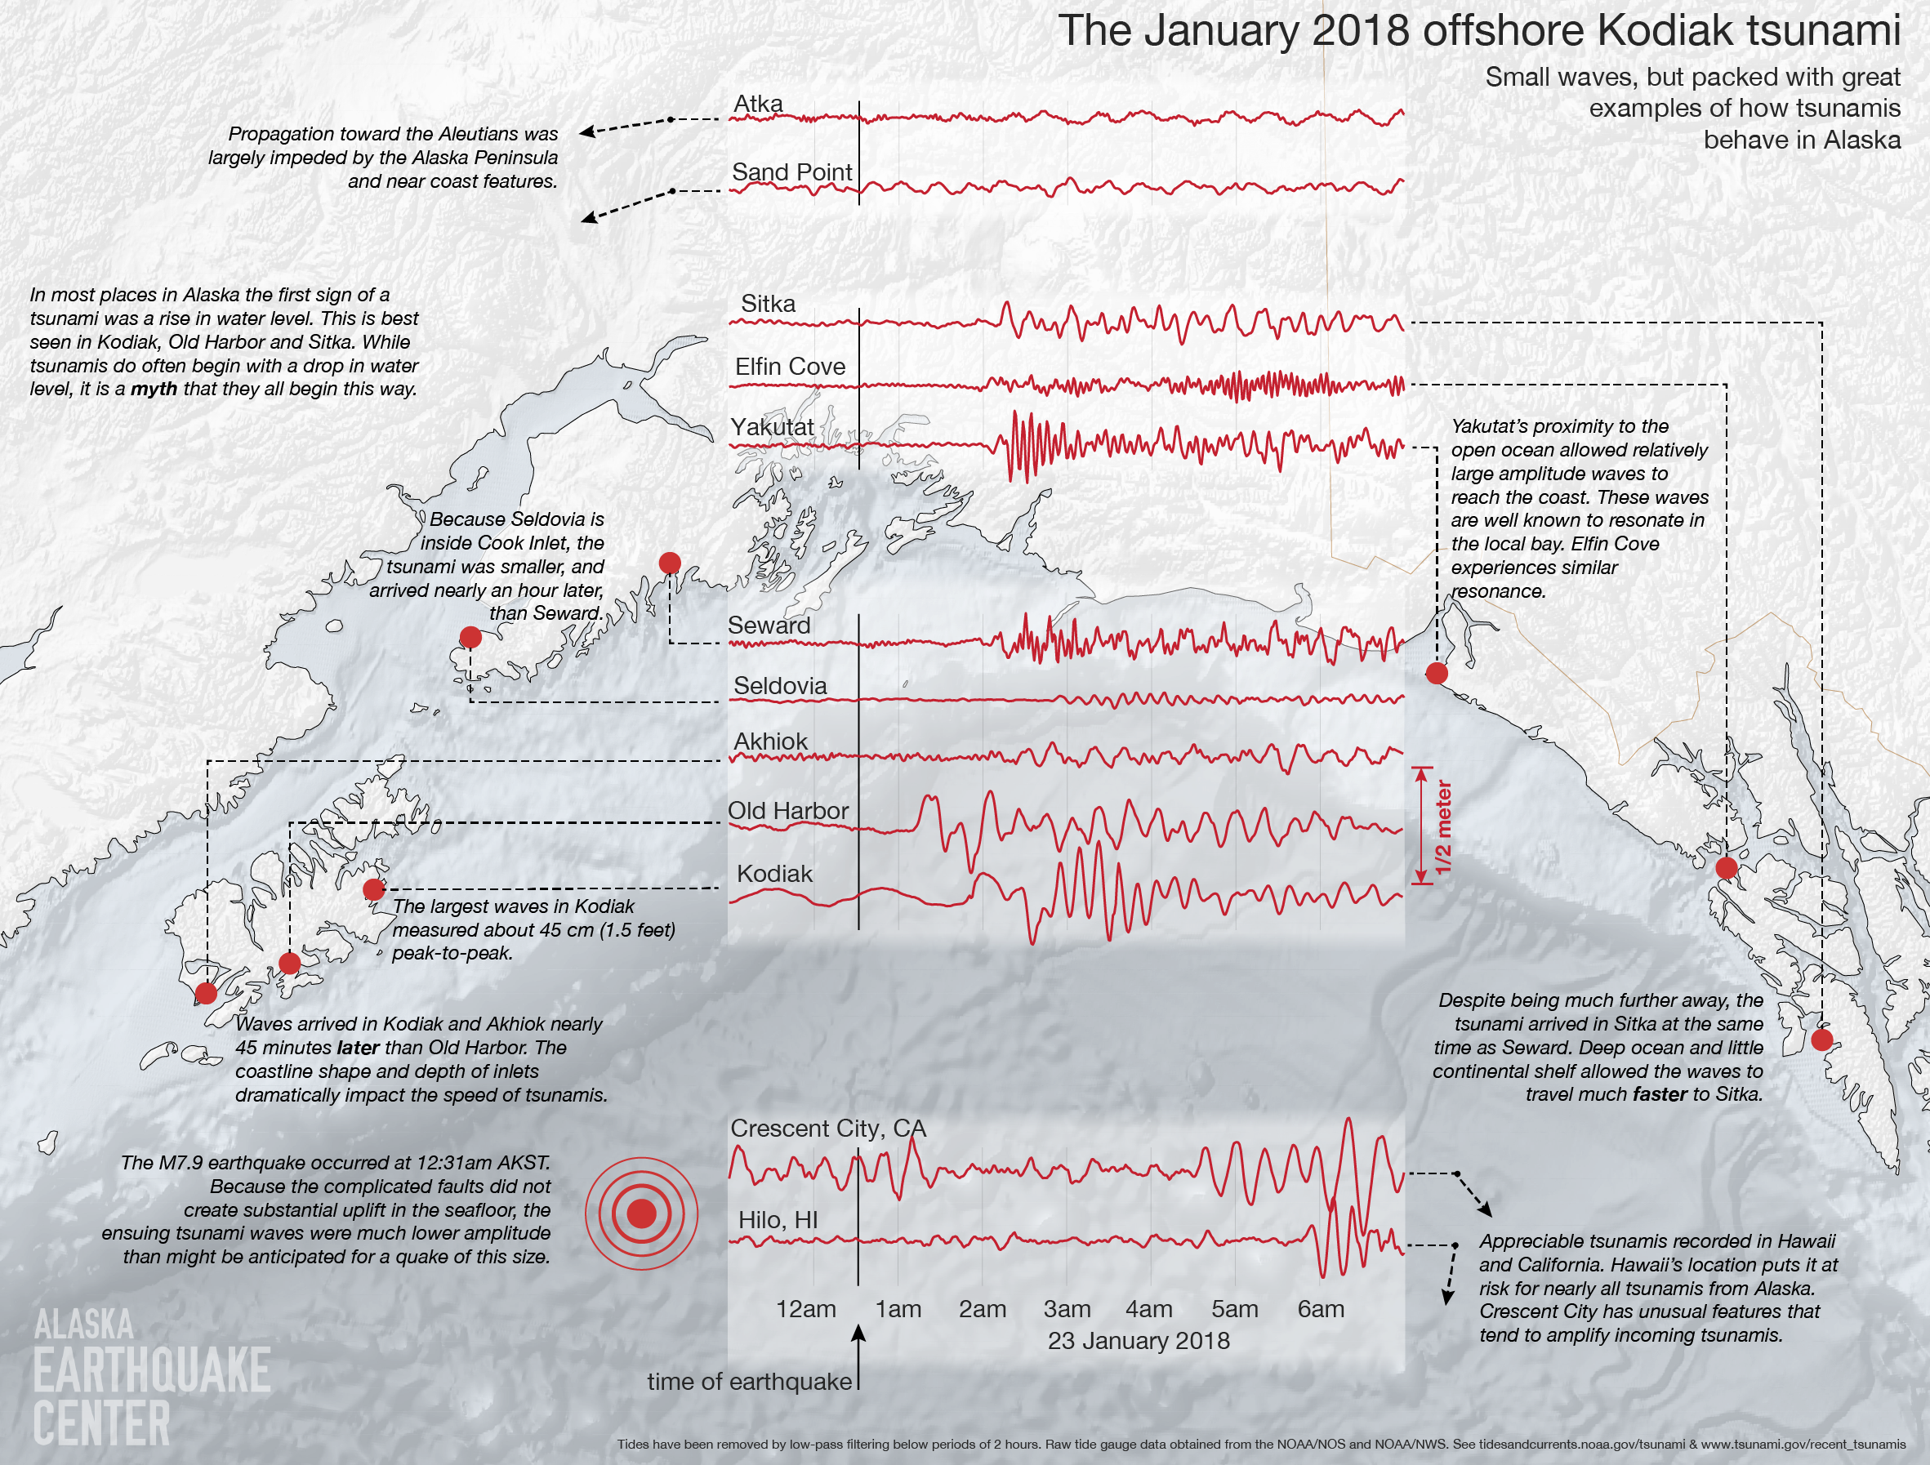
Complicated Tsunami from a Relatively Simple Earthquake
Notes:
Map from Alaska Earthquake Center https://earthquake.alaska.edu/tsunami-observations-offshore-kodiak-earthquake

Slide 9
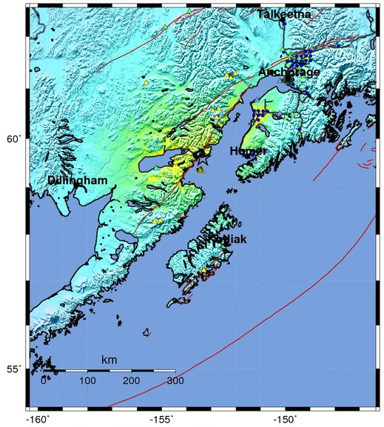
Jan 24, 2016 Magnitude 7.1 Pedro Bay
Depth = 127.8 km (79.4 miles). Ground shaking would have been more severe if the earthquake had occurred at shallower depth.
No reports of injuries, but four homes lost to natural gas explosions or fire.
Moderate to strong shaking from this earthquake was felt within 150 km of epicenter.
USGS Estimated shaking Intensity from M 7.1 Earthquake
Notes:
ShakeMap from US Geological Survey National Earthquake Information Center. https://earthquake.usgs.gov/earthquakes/eventpage/us10004gqp#shakemap

Slide 10
Cross Section Through Anchorage
M7.1 Pedro Bay Earthquake
Iniskin earthquake occurred within Pacific Plate at 128 km depth.
Caused by bending and shearing of Pacific Plate during subduction.
Notes:
Illustration from IRIS Animation Alaska: Tectonics and Earthquakes
https://www.iris.edu/hq/inclass/animation/alaska_tectonics_and_earthquakes

Slide 11
Denali 2002 Crustal Fault Earthquake
Nov 3, 2002
M7.9
Depth = 5 km
90 second rupture interval. Largest inland earthquake in North America in almost 150 years.
Notes:
ShakeMap from US Geological Survey National Earthquake Information Center. https://earthquake.usgs.gov/earthquakes/eventpage/usp000bg0m#executive
The 1949 M8.1 earthquake on the Queen Charlotte fault was the largest instrumentally recorded strike-slip earthquake in North American history. Denali 2002 is second largest instrumentally recorded strike-slip earthquake in North American history. Denali 2002 is largest inland earthquake in North America in almost 150 years. 1857 Ft Tejon CA earthquake was comparable. 1906 San Francisco earthquake was probably smaller.

Slide 12
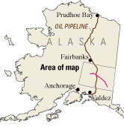
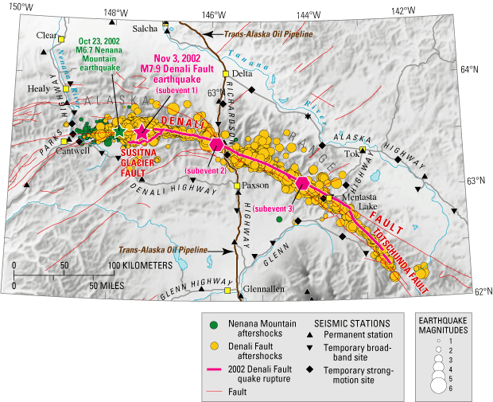
Denali 2002 Foreshock, Mainshock, Aftershocks
Maximum displacement > 8 m (~30 feet). Pipeline was designed to withstand ground shaking and offset by earthquakes. It did.
Notes:
USGS Fact Sheet 014-03 Rupture in South-Central Alaska—The Denali Fault Earthquake of 2002
https://pubs.usgs.gov/fs/2003/fs014-03/
Alaska Earthquake Center M 7.9 Denali Fault earthquake of November 3, 2002
http://www.aeic.alaska.edu/Seis/Denali_Fault_2002/#Overview

Slide 13
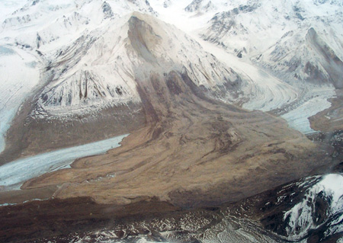
Denali 2002 Earthquake Effects
Seismic Landslides, Liquefaction, Triggered EQs in Yellowstone & CA, Seiche in Lake Union.
Notes:
Photo source: USGS Fact Sheet 014-03 Rupture in South-Central Alaska—The Denali Fault Earthquake of 2002
https://pubs.usgs.gov/fs/2003/fs014-03/
“Violent, prolonged shaking from the quake triggered thousands of landslides, especially on the steep slopes of the Alaska Range. Mountainsides gave way, burying the valleys and glaciers below in deposits of rock and ice as much as 15 feet thick. The majority of landslides clustered in a narrow band extending about 8 to 12 miles on either side of the rupture. One facility that was badly damaged by the earthquake was the runway at Northway Airport, 40 miles from the eastern part of the November 3, 2002, fault rupture. The runway was rendered unusable by lateral spreading, accompanied by sand boils. These effects were the result of a phenomenon called "liquefaction," in which strong, prolonged earthquake shaking transforms loose, water-saturated sediments into a liquid slurry. Areas that experienced liquefaction during the earthquake include much of the Tanana River Valley north and east of the rupture and other locations near smaller rivers. Like some other large earthquakes, the Denali Fault quake triggered small shocks as far as 2,000 miles away, mainly in volcanic areas. Yellowstone National Park had the most energetic swarm of triggered earthquakes. Following the Denali Fault earthquake, Lake Union in Seattle experienced an earthquake-induced seiche, or water sloshing, which knocked many houseboats off their moorings and caused minor damage. Seiches were seen as far away as Lake Pontchartrain in Louisiana.”

Slide 14
Alaska Tectonics & Earthquakes Animation
Notes:
IRIS Animation Alaska: Tectonics and Earthquakes
https://www.iris.edu/hq/inclass/animation/alaska_tectonics_and_earthquakes
https://www.youtube.com/watch?v=2nMiVd0zo_Y

Slide 15
Alaska Earthquake Hazard Map
Notes:
Graphic from Are You Prepared for the Next Big Earthquake in Alaska?
https://earthquake.alaska.edu/sites/default/files/are-you-prepared_Nov2016-web.pdf
Based on Wesson, Robert L., Boyd, Oliver S., Mueller, Charles S., Bufe, Charles G., Frankel, Arthur D., Petersen, Mark D., 2007, Revision of time-Independent probabilistic seismic hazard maps for Alaska: U.S. Geological Survey Open-File Report 2007-1043.

Slide 16
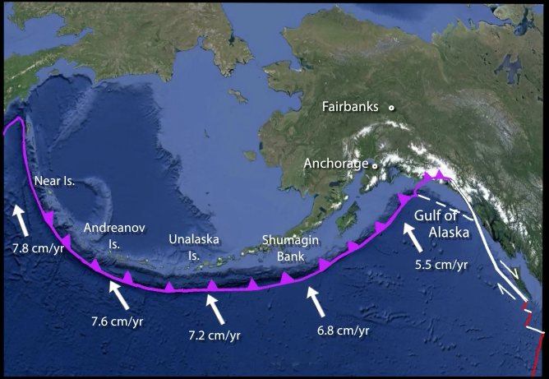
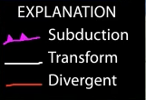
Alaska–Aleutian Subduction Zone
North American Plate
Pacific Plate
In most locations, the shallow plate boundary is “locked and loading”.
Notes:
Illustration from IRIS Animation Alaska: Tectonics and Earthquakes
https://www.iris.edu/hq/inclass/animation/alaska_tectonics_and_earthquakes

Slide 17
GPS Stations in Alaska
Notes:
Map from UNAVCO Velocity Viewer
http://www.unavco.org/software/visualization/GPS-Velocity-Viewer/GPS-Velocity-Viewer.html
A similar but simplified version of this map is available as a wall poster from UNAVCO (https://www.unavco.org/education/outreach/giveaways/velocity-map-posters/velocity-map-posters.html)
Although the term GPS (Global Positioning System) is more commonly used in everyday language, it officially refers only to the USA's constellation of satellites. GNSS (Global Navigation Satellite System) is a universal term that refers to all satellite navigation systems including those from the USA (GPS), Russia (GLONASS), European Union (Galileo), China (BeiDou), and others.
In this presentation, we use the term GPS even though, technically, some of the data may be coming from satellites in other systems.

Slide 18
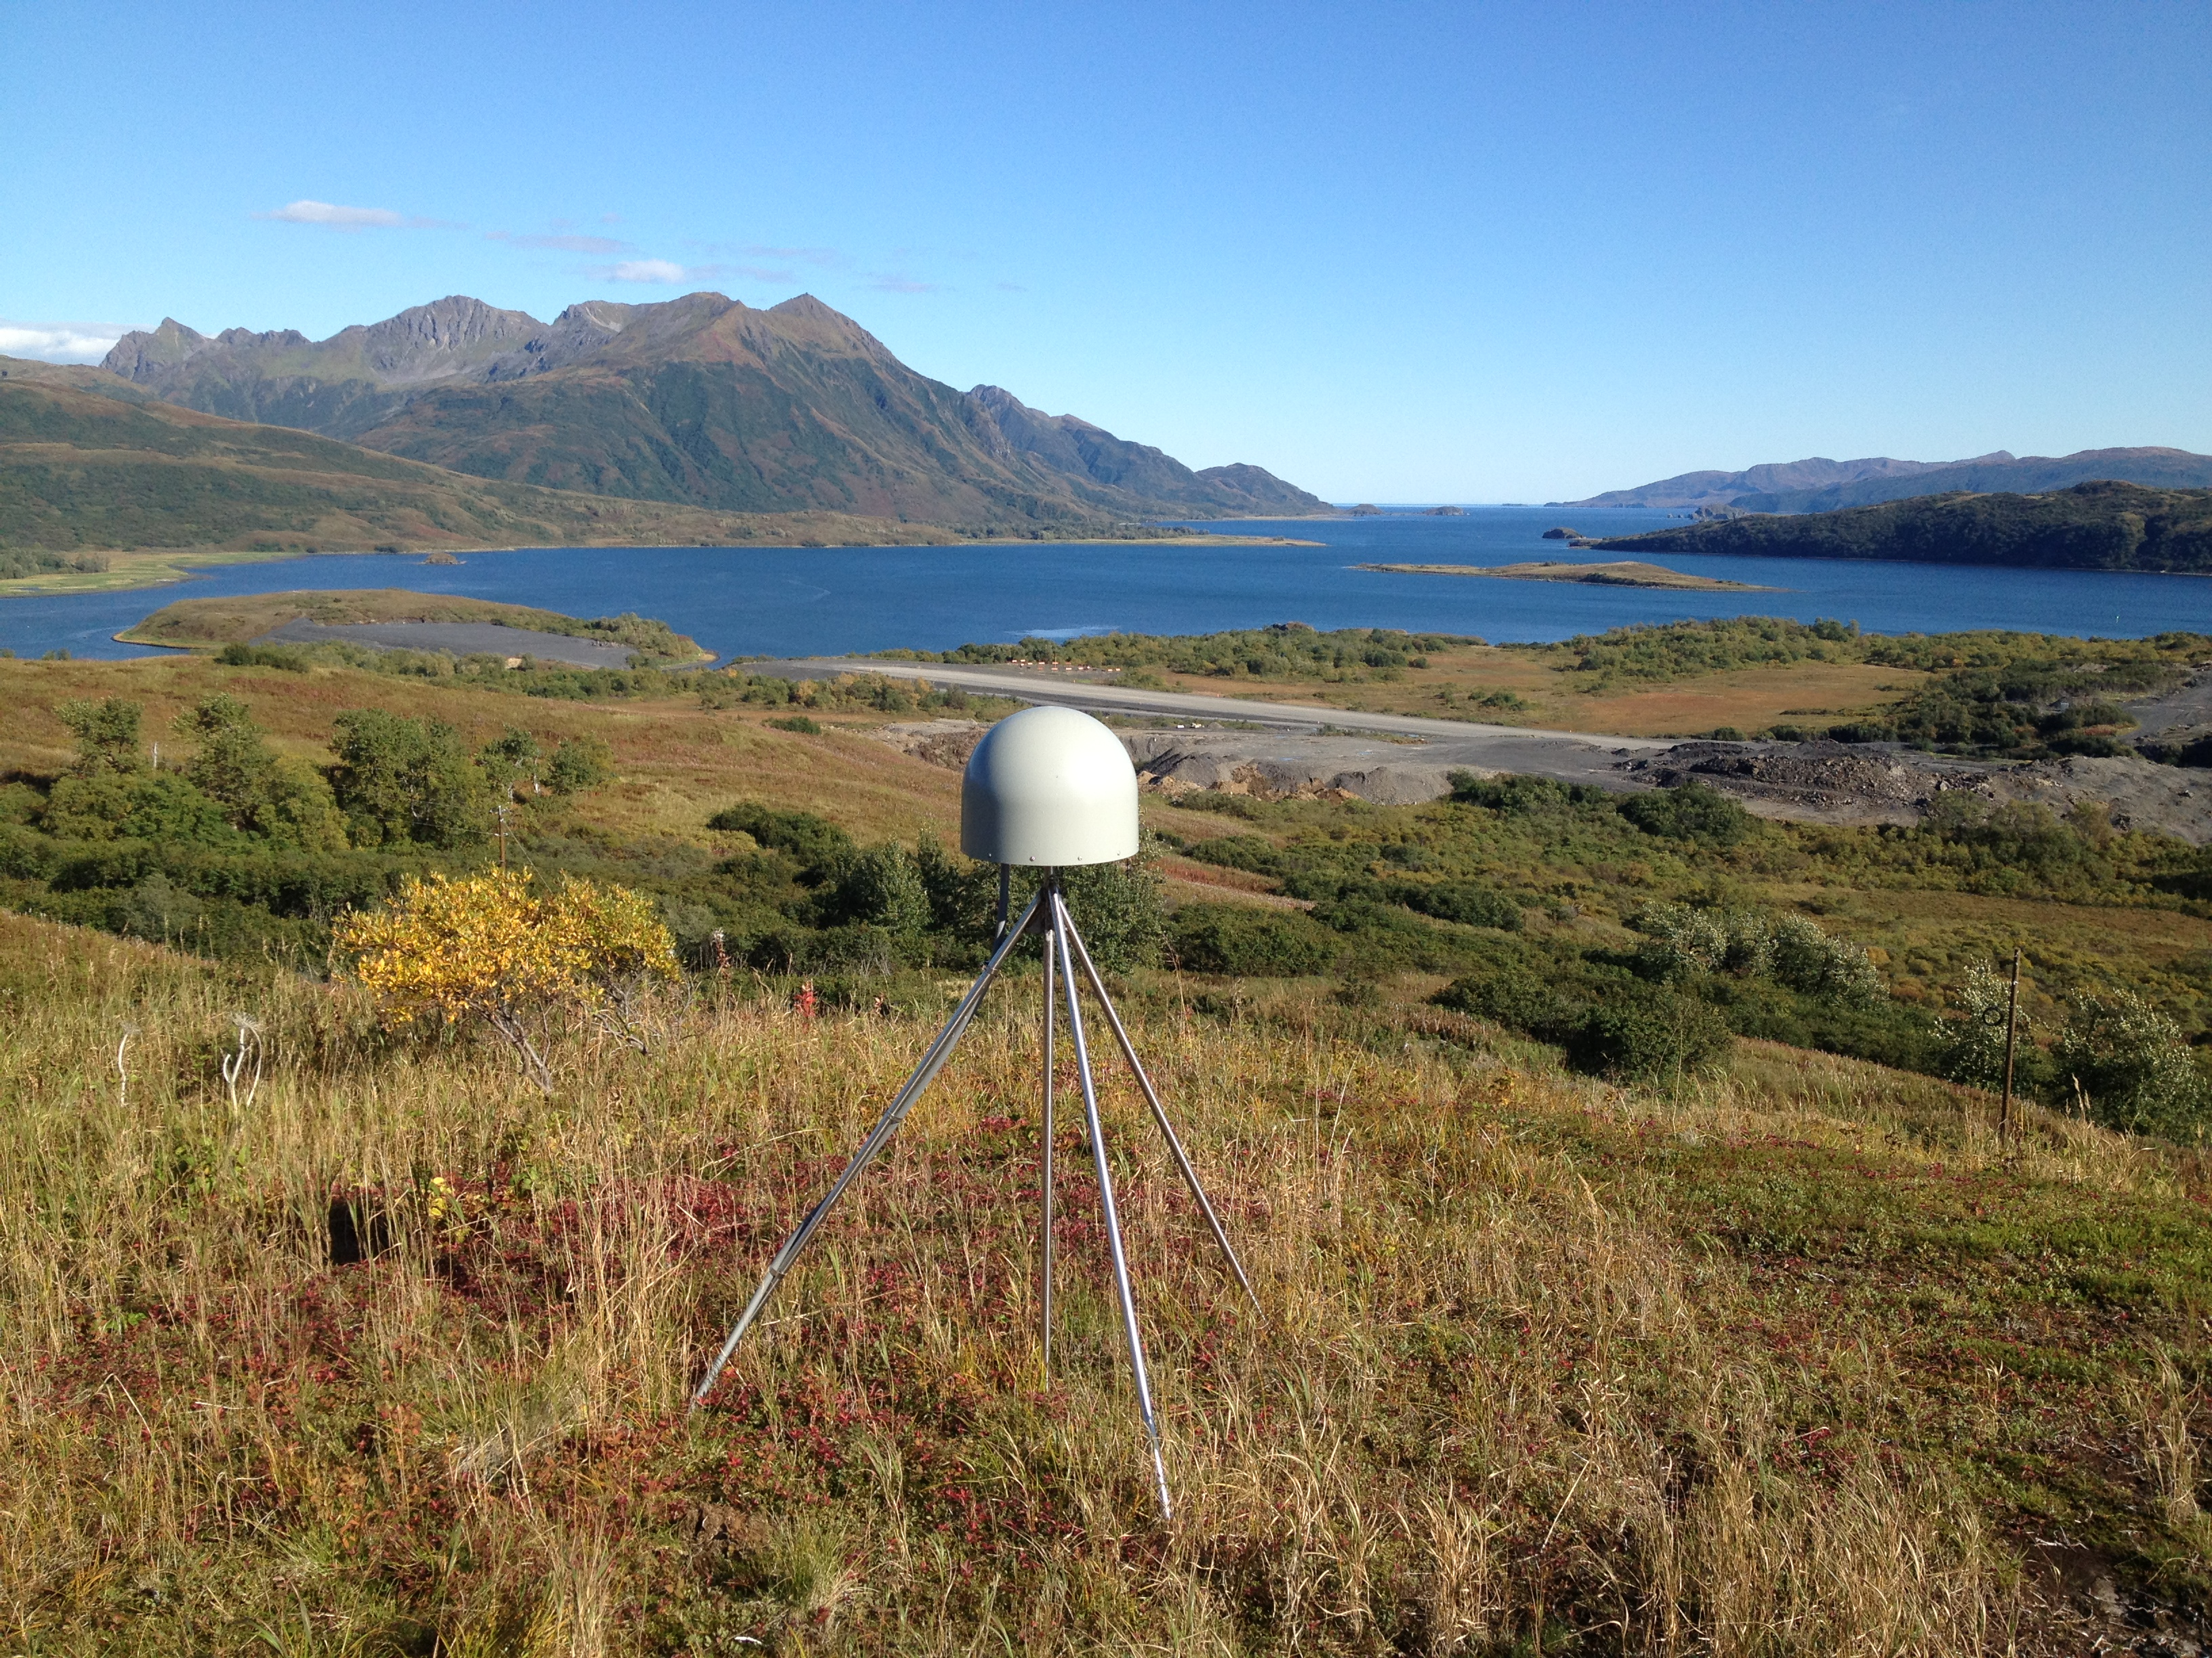
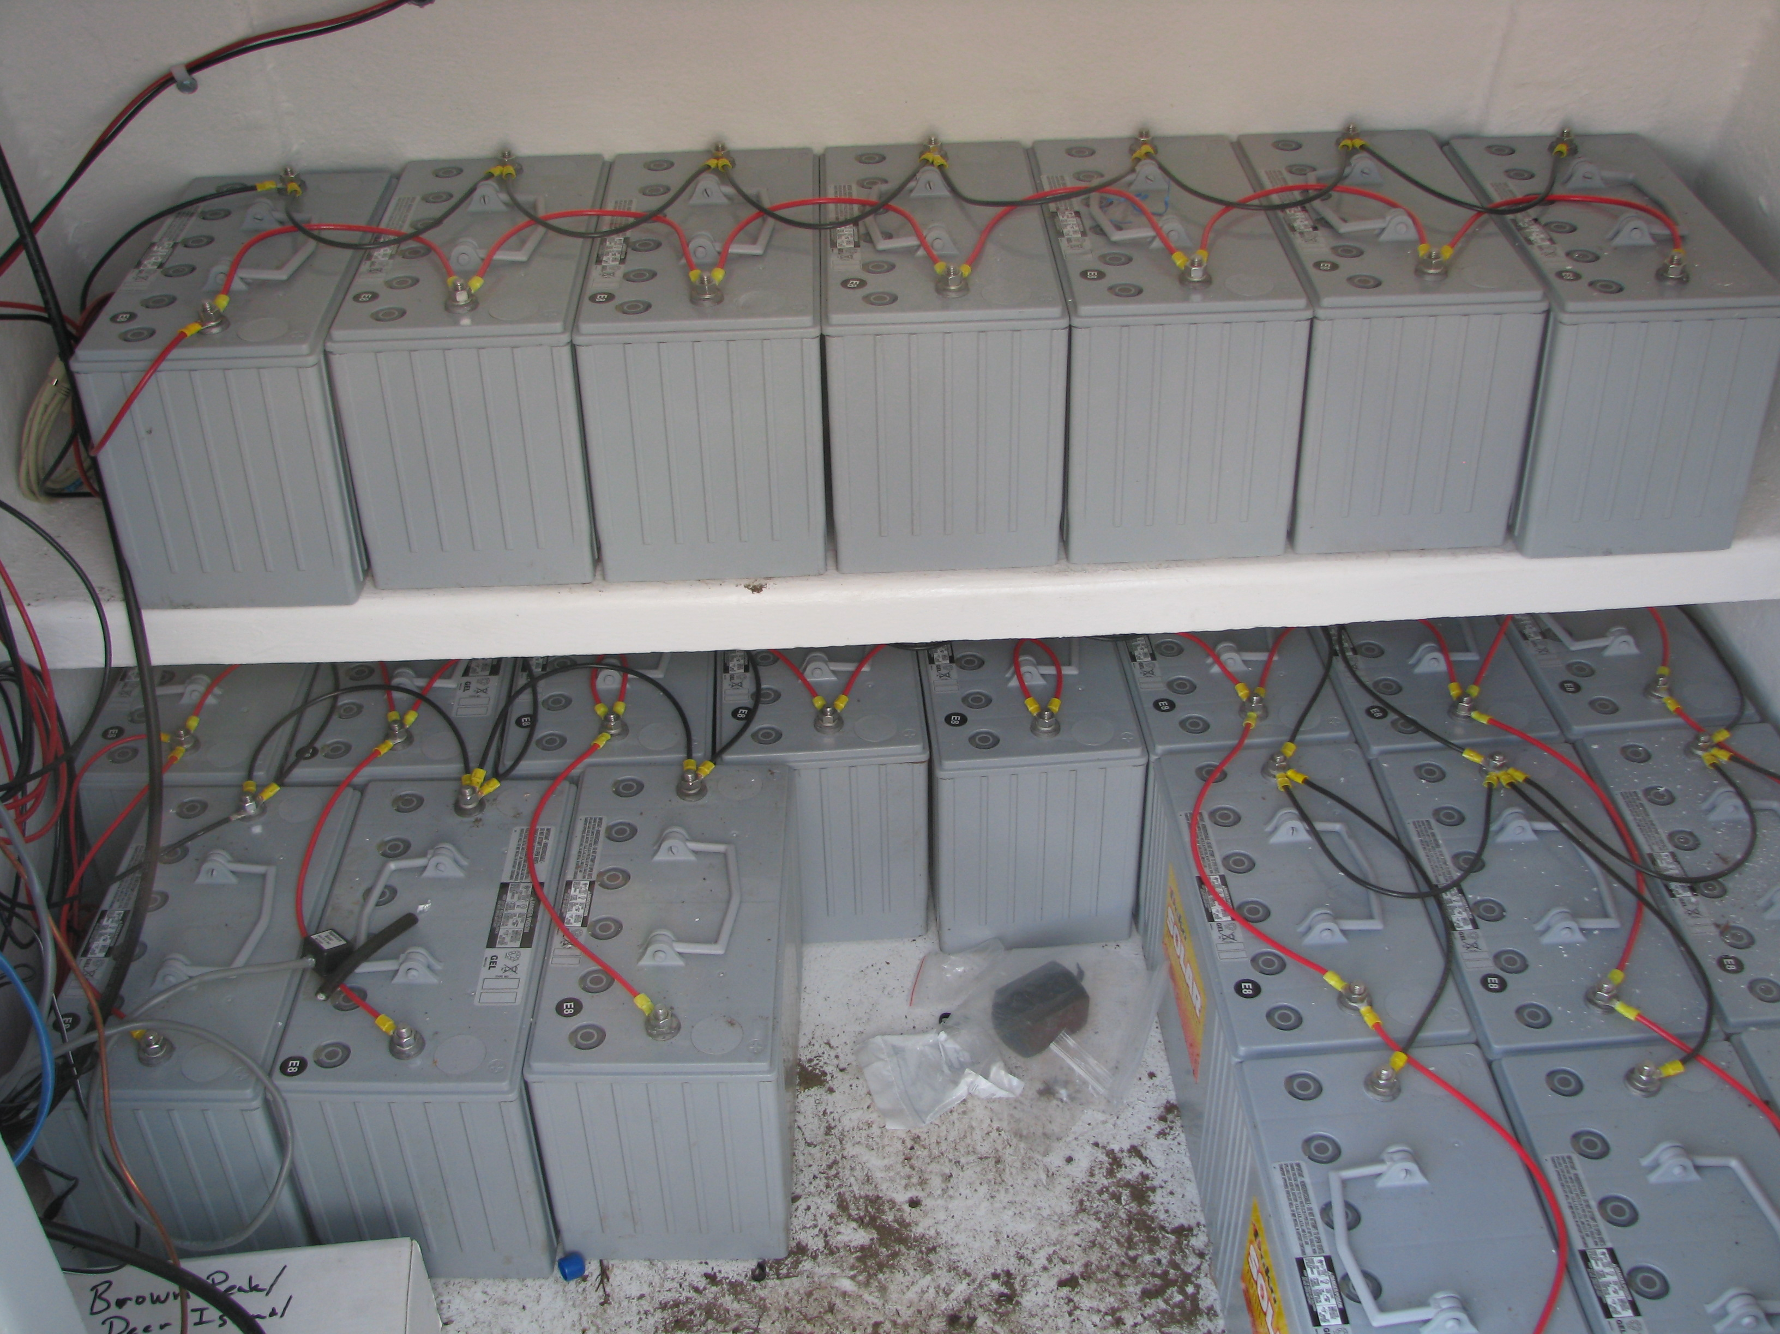
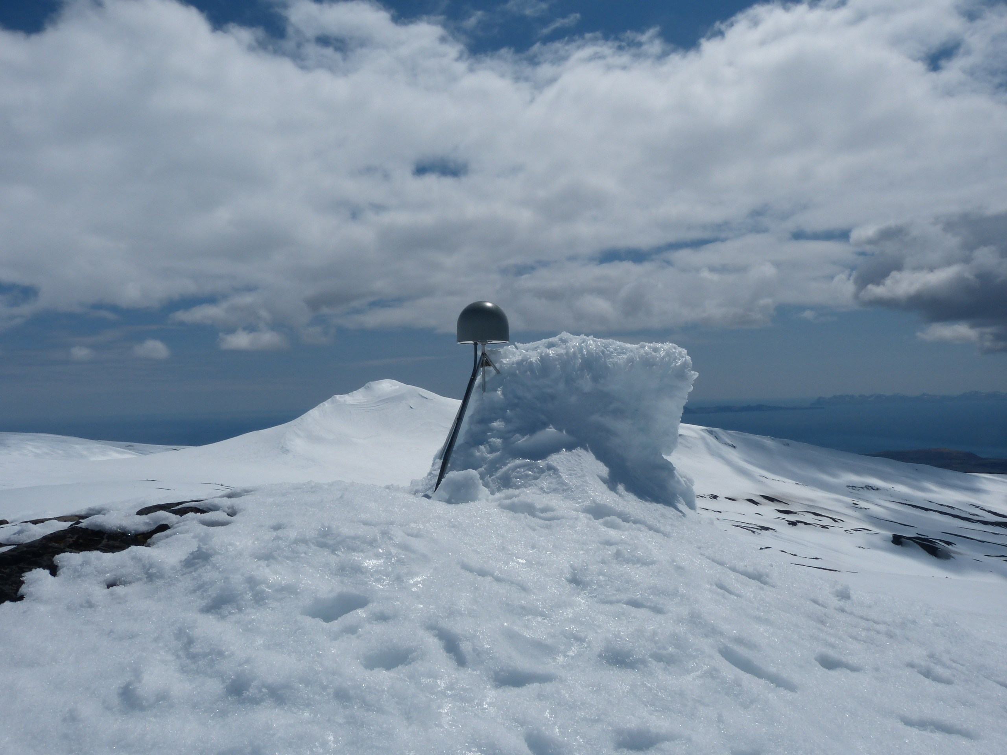
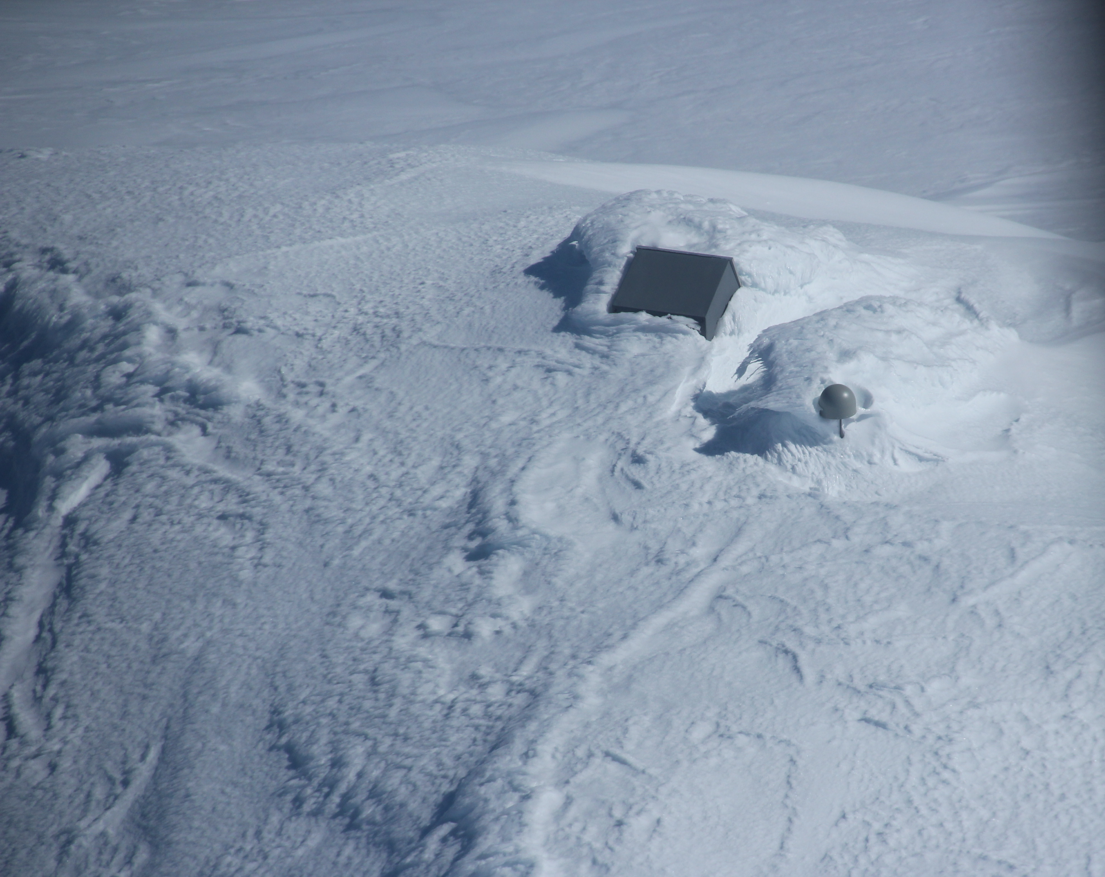
Alaska GPS Challenges
Notes:
Photos from UNAVCO Plate Boundary Observatory in Alaska. https://unavco.smugmug.com/UNAVCO-Calendar/2018-Photos/i-hxjjjwN
Alaska provides more than the usual field challenges for maintaining geophysical instruments. Besides the shear size and remoteness of many places, snow and ice is much more of a problem. Long dark winters mean sometimes enormous battery banks are needed rather than just two to four. Alders can also be a menace quickly growing over sites that cannot be visited often.

Slide 19
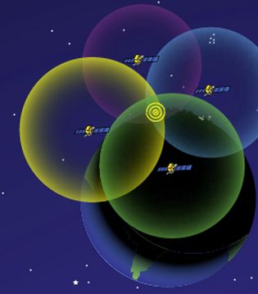
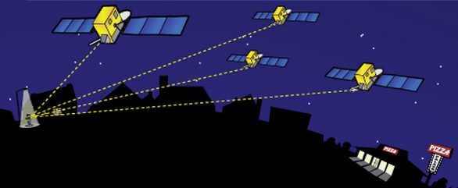
How GPS location is determined
Antenna position is determined by calculating the distances to at least 4 satellites. This enables the solving for 4 variables: x, y, z and time.
Notes:
Although 4 is a technical minimum number of satellites, for geoscience research work it is highly recommended to have at least 6 satellites.
Although people will often refer to this process and “triangulation” in fact it is “trilateration” because it depends on distances rather than angles (same is true for earthquake epicenter locating although the term is frequently misused).
For a nice explanation of trilateration versus triangulation visit https://gisgeography.com/trilateration-triangulation-gps/.
Images from NASA (public domain) http://spaceplace.nasa.gov/gps-pizza/en/

Slide 20
Demonstration: Locating Receiver With GPS
Notes:
Video of Roger Groom, Mt Tabor Middle School, Portland, OR, describing this classroom demonstration:
http://www.youtube.com/watch?feature=player_embedded&v=s_CeiMjO5Pc#!
Video also available from IRIS Education and Outreach at links below:
http://www.iris.edu/hq/inclass/video/gps_monitors_deformation_in_subduction_zone_part_1_intro
http://www.iris.edu/hq/inclass/video/gps_monitors_deformation_in_subduction_zone_part_2_using_real_data

Slide 21
Exploring Plate Motions with GPS (p.207)
How GPS Measures Plate Motions
Notes:
https://www.youtube.com/watch?v=ucEOAR6U2js&t=162s

Slide 22
Transect Across Prince William Sound
AC 32 Mt. Susitna
AC 20 Girdwood
AC 79 Montague Is.
Notes:
Map from UNAVCO Velocity Viewer
http://www.unavco.org/software/visualization/GPS-Velocity-Viewer/GPS-Velocity-Viewer.html

Slide 23
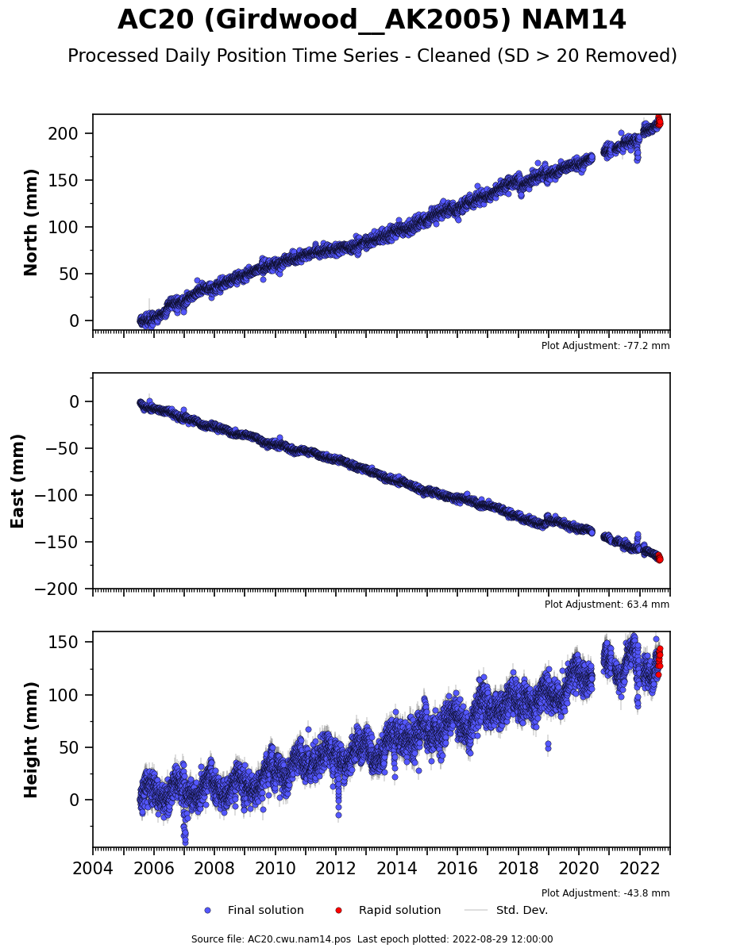
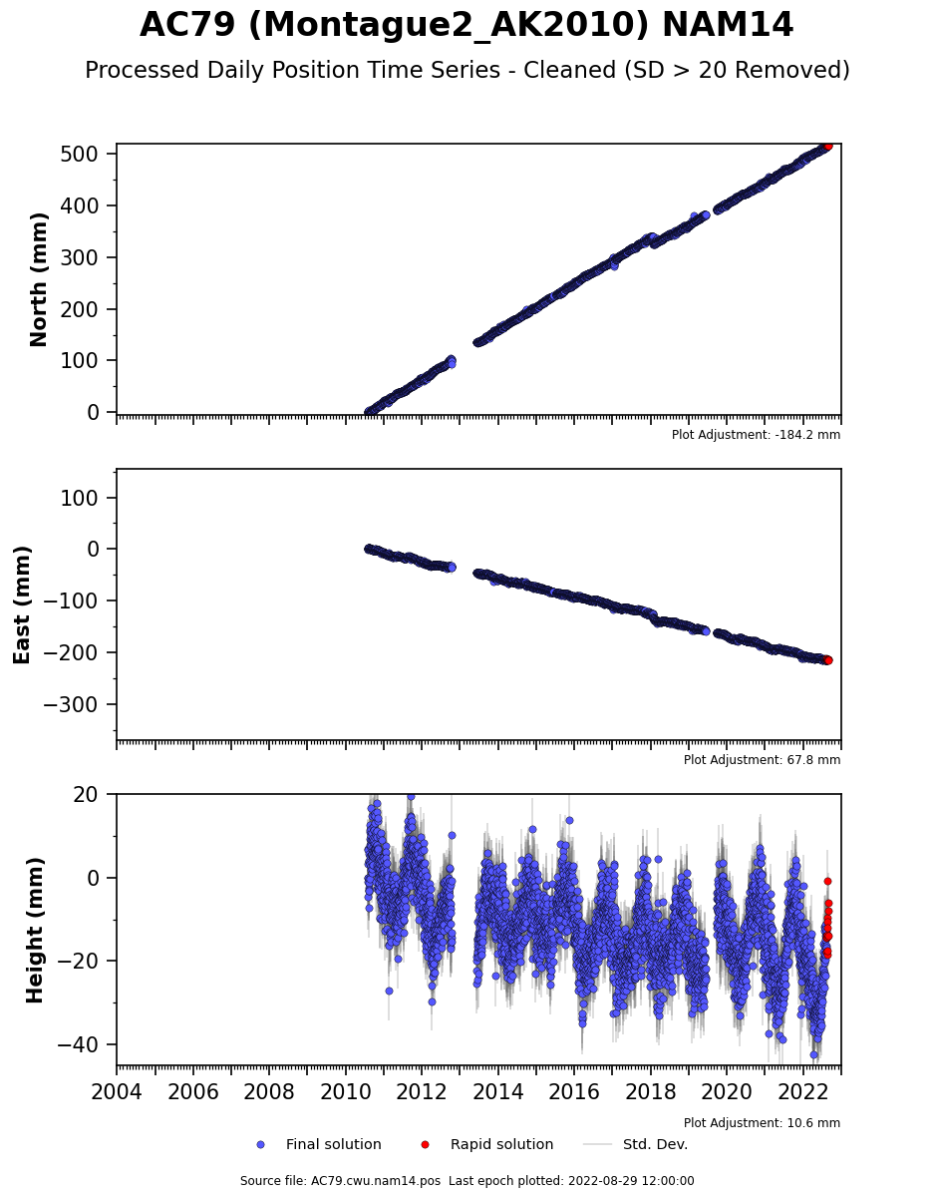
Alaska GPS Analysis (p.187)
Horizontal Rates of Motion - resolve GPS vectors
210 mm
500 mm
North: 210 mm – 0 mm = 210 mm
North: 500 mm – 0 mm = 500 mm
=12.4 mm/yr
=41.7 mm/yr
0 mm
0 mm
0 mm
East: -160 mm – 0 mm = -160 mm
East: -200 mm – 0 mm = -200 mm
0 mm
=-16.7 mm/yr
=-9.4 mm/yr
-200 mm
-160 mm
2005.5
17 years
2022.5
2010.5
12 years
2022.5
= 15.6 mm/yr NW
= 44.9 mm/yr NNW

Slide 24
Transect Across Prince William Sound
West
Velocity (mm/yr)
East
30
20
10
0
10
50
50
North
40
40
Horizontal velocities:
AC 79 44.9 mm/yr
AC20 15.6 mm/yr
AC32 4.8 mm/yr
30
AC79 Montague Island 48 mm/yr
30
Velocity (mm/yr)
Velocity (mm/yr)
20
20
10
10
AC20 Girdwood
15 mm/yr
0
0
AC32 Mt Susitna
5 mm/yr
South
10
30
20
10
0
10
West
Velocity (mm/yr)
10
East
Notes:
Graph by Robert Butler.

Slide 25
NW – SE Compression of Prince William Sound
Alaska Range
AC32
Anchorage
Chugach
Mountains
25mm/yr
North American Plate
Cook Inlet
AC20
Kenai Peninsula
Prince William Sound
AC79
Pacific Plate
North American Plate
Trench
56 mm/yr
Aleutian
Kodiak Island
Alaska –
Pacific Plate
Notes:
Map from UNAVCO Velocity Viewer
http://www.unavco.org/software/visualization/GPS-Velocity-Viewer/GPS-Velocity-Viewer.html

Slide 26
Role of GPS in Earthquake Early Warning
GPS observations are critical to Earthquake Early Warning for great subduction zone earthquakes.
Notes:
Illustration from IRIS Animation Earthquake Early Warning: Pacific Northwest subduction zone
https://www.iris.edu/hq/inclass/animation/earthquake_early_warning_pacific_northwest_subduction_zone

Slide 27
Prince William Sound
Old Chenega
20 km
Notes:
Map from Google Maps at link below.
https://www.google.com/maps/place/Prince+William+Sound,+Alaska/@60.5936566,-147.2879222,8z/data=!4m2!3m1!1s0x56b79499409d9821:0x62fee6a17a55ad8b

Slide 28
Prince William Sound Cross Section
Notes:
From IRIS animation Subduction Zone: Tsunamis Generated by Megathrust Earthquakes
https://www.iris.edu/hq/inclass/animation/subduction_zone_tsunamis_generated_by_megathrust_earthquakes

Slide 29
Vertical Displacement from 1964 Earthquake
Uplift of seafloor was source of the “tectonic” tsunami that affected Prince William Sound, Kenai Peninsula, and Kodiak Is.
Notes:
Map from: TSUNAMI INUNDATION MAPS OF SEWARD AND NORTHERN RESURRECTION BAY, ALASKA, E.N. Suleimani, D.J. Nicolsky, D.A. West, R.A. Combellick, and R.A. Hansen, Report of Investigations 2010-1, DIVISION OF GEOLOGICAL & GEOPHYSICAL SURVEYS, STATE OF ALASKA DEPARTMENT OF NATURAL RESOURCES.
http://www.dggs.alaska.gov/pubs/id/21001
Coseismic uplift model from: Suito, H., and J. T. Freymueller (2009), A viscoelastic and afterslip postseismic deformation model for the 1964 Alaska
earthquake, J. Geophys. Res., 114, B11404, doi:10.1029/2008JB005954

Slide 30
A Fountain of Information on Effects of 1964 Earthquake & Tsunami on Communities
USGS Professional Paper 542-A to 542-G
Notes:
US Geological Survey Professional Paper 542-A through 542-G, The Alaska Earthquake of March 27, 1964, Effects on Communities.
https://pubs.usgs.gov/pp/0542/

Slide 31
Seward in Resurrection Bay
Notes:
From: TSUNAMI INUNDATION MAPS OF SEWARD AND NORTHERN RESURRECTION BAY, ALASKA, E.N. Suleimani, D.J. Nicolsky, D.A. West, R.A. Combellick, and R.A. Hansen, Report of Investigations 2010-1, DIVISION OF GEOLOGICAL & GEOPHYSICAL SURVEYS, STATE OF ALASKA DEPARTMENT OF NATURAL RESOURCES.
http://www.dggs.alaska.gov/pubs/id/21001

Slide 32
March 27, 1964 Tides in Resurrection Bay
Tsunamis ride the tides. Fortunate to have a low tide (and full moon) during 1964 Great Alaska earthquake and tsunami.
Notes:
From: TSUNAMI INUNDATION MAPS OF SEWARD AND NORTHERN RESURRECTION BAY, ALASKA, E.N. Suleimani, D.J. Nicolsky, D.A. West, R.A. Combellick, and R.A. Hansen, Report of Investigations 2010-1, DIVISION OF GEOLOGICAL & GEOPHYSICAL SURVEYS, STATE OF ALASKA DEPARTMENT OF NATURAL RESOURCES.
http://www.dggs.alaska.gov/pubs/id/21001

Slide 33
Seward Coseismic Subsidence
Land dropped 1.1 meters at Seward during 1964 earthquake. Land subsidence will increase tsunami inundation. Not good.
Notes:
From: TSUNAMI INUNDATION MAPS OF SEWARD AND NORTHERN RESURRECTION BAY, ALASKA, E.N. Suleimani, D.J. Nicolsky, D.A. West, R.A. Combellick, and R.A. Hansen, Report of Investigations 2010-1, DIVISION OF GEOLOGICAL & GEOPHYSICAL SURVEYS, STATE OF ALASKA DEPARTMENT OF NATURAL RESOURCES.
http://www.dggs.alaska.gov/pubs/id/21001

Slide 34
Seward Before & After March 27, 1964
13 Fatalities
Highest Inundation
After 30 seconds of shaking, a landslide including part of waterfront slid into the bay rupturing fuel tanks and igniting oil. Two under-water landslides occurred at same time. Series of three landslide-generated waves up to 6 meters high arrived during first 3 minutes of shaking. Tectonic tsunami, covered in burning oil, arrived ~20 minutes after ground shaking stopped. Third tectonic tsunami wave was highest at ~8 meters height. Wind blowing toward bay prevented entire town from burning.
Notes:
From: TSUNAMI INUNDATION MAPS OF SEWARD AND NORTHERN RESURRECTION BAY, ALASKA, E.N. Suleimani, D.J. Nicolsky, D.A. West, R.A. Combellick, and R.A. Hansen, Report of Investigations 2010-1, DIVISION OF GEOLOGICAL & GEOPHYSICAL SURVEYS, STATE OF ALASKA DEPARTMENT OF NATURAL RESOURCES.
http://www.dggs.alaska.gov/pubs/id/21001

Slide 35
Seward 1964 Landslides
Detailed bathymetric studies allow reconstruction of sizes of landslides.
Modeling of tsunami generated by three landslides at head of bay can reproduce the observed wave heights and sequence.
Modeling of tectonic tsunami reproduces arrival times and height of longer period waves.
Notes:
From: TSUNAMI INUNDATION MAPS OF SEWARD AND NORTHERN RESURRECTION BAY, ALASKA, E.N. Suleimani, D.J. Nicolsky, D.A. West, R.A. Combellick, and R.A. Hansen, Report of Investigations 2010-1, DIVISION OF GEOLOGICAL & GEOPHYSICAL SURVEYS, STATE OF ALASKA DEPARTMENT OF NATURAL RESOURCES.
http://www.dggs.alaska.gov/pubs/id/21001

Slide 36
Tectonic Tsunami
Modeling of Tsunamis in Seward
Landslide-generated Tsunami
Observed
In some areas, tectonic tsunami advanced farther on land.
Observed
Notes:
From: TSUNAMI INUNDATION MAPS OF SEWARD AND NORTHERN RESURRECTION BAY, ALASKA, E.N. Suleimani, D.J. Nicolsky, D.A. West, R.A. Combellick, and R.A. Hansen, Report of Investigations 2010-1, DIVISION OF GEOLOGICAL & GEOPHYSICAL SURVEYS, STATE OF ALASKA DEPARTMENT OF NATURAL RESOURCES.
http://www.dggs.alaska.gov/pubs/id/21001

Slide 37
Whittier After 1964 Tsunami
Whittier subsided 1.6 m during the earthquake. 13 out of 70 people in Whittier in 1964 perished in the tsunamis. Three waves generated by landslides arrived during ground shaking to completely destroy buildings of two lumber companies. Fire destroyed fuel-storage tanks at waterfront.
Notes:
R. Kachadoorian, Effects of the Earthquake Of March 27,1964 At Whittier, Alaska, US Geological Survey Professional Paper 542-B, 1965.

Slide 38
Whittier 1964 Landslides
Detailed bathymetric studies of Passage Canal allow reconstruction of sizes of landslides. Modeling of tsunami generated by three landslides can reproduce the observed landslide-generated tsunami.
Notes:
From TSUNAMI INUNDATION MAPS OF WHITTIER AND WESTERN PASSAGE CANAL, ALASKA, D.J. Nicolsky, E.N. Suleimani, R.A. Combellick, and R.A. Hansen, Report of Investigations 2011-7, DIVISION OF GEOLOGICAL & GEOPHYSICAL SURVEYS, STATE OF ALASKA DEPARTMENT OF NATURAL RESOURCES. http://www.dggs.alaska.gov/pubs/id/23244

Slide 39
Modeled Landslide-Generated Tsunami in Whittier
North shore runup over 30 meters.
Whittier Creek runup ~ 16 meters.
Whittier runup ~ 13 meters.
Model reasonably fits observed landslide-generated tsunami.
Notes:
From TSUNAMI INUNDATION MAPS OF WHITTIER AND WESTERN PASSAGE CANAL, ALASKA, D.J. Nicolsky, E.N. Suleimani, R.A. Combellick, and R.A. Hansen, Report of Investigations 2011-7, DIVISION OF GEOLOGICAL & GEOPHYSICAL SURVEYS, STATE OF ALASKA DEPARTMENT OF NATURAL RESOURCES. http://www.dggs.alaska.gov/pubs/id/23244

Slide 40
Modeled Tectonic Tsunami at Whittier
Tectonic tsunami arrived ~ 1 hour after earthquake but did not inundate Whittier and was not even noticed by eyewitness observers. Three meter maximum tectonic tsunami height in Whittier much smaller than ~8 meter maximum tectonic tsunami height in Seward. Why might that be? Let’s explore with Wave Tank Model.
Notes:
From TSUNAMI INUNDATION MAPS OF WHITTIER AND WESTERN PASSAGE CANAL, ALASKA, D.J. Nicolsky, E.N. Suleimani, R.A. Combellick, and R.A. Hansen, Report of Investigations 2011-7, DIVISION OF GEOLOGICAL & GEOPHYSICAL SURVEYS, STATE OF ALASKA DEPARTMENT OF NATURAL RESOURCES. http://www.dggs.alaska.gov/pubs/id/23244
Simulated water level dynamics in the Whittier harbor and suggests that the maximum height of the waves that hit Whittier was about 3.5 m (11.5 ft) at the MLW tide, if the local 1.6 m
(5.3 ft) subsidence is taken into account. Note that this wave height is within the tidal range for the community and does not produce flooding.

Slide 41
Vertical Displacement from 1964 Earthquake
Notes:
Map from: TSUNAMI INUNDATION MAPS OF SEWARD AND NORTHERN RESURRECTION BAY, ALASKA, E.N. Suleimani, D.J. Nicolsky, D.A. West, R.A. Combellick, and R.A. Hansen, Report of Investigations 2010-1, DIVISION OF GEOLOGICAL & GEOPHYSICAL SURVEYS, STATE OF ALASKA DEPARTMENT OF NATURAL RESOURCES.
http://www.dggs.alaska.gov/pubs/id/21001
Coseismic uplift model from: Suito, H., and J. T. Freymueller (2009), A viscoelastic and afterslip postseismic deformation model for the 1964 Alaska
earthquake, J. Geophys. Res., 114, B11404, doi:10.1029/2008JB005954

Slide 42
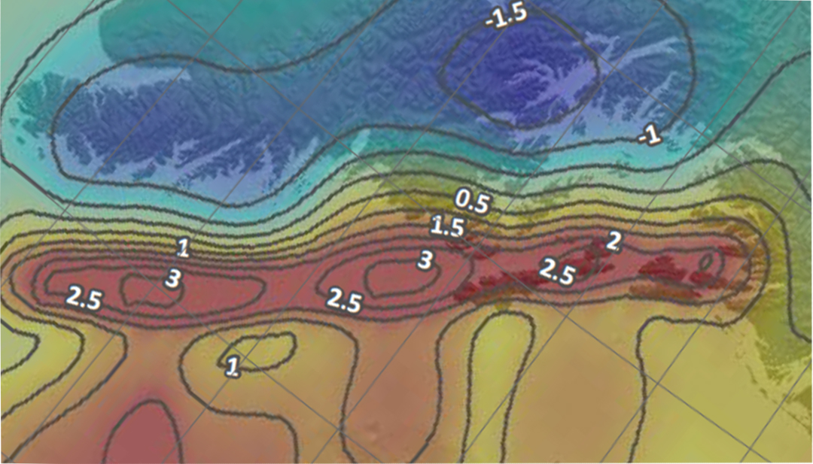
Vertical Displacement from 1964 Earthquake
Tsunami Inundation (p. 220)
Whittier
Seward
Notes:
Geographic map from Google Maps at link below.
https://www.google.com/maps/place/Prince+William+Sound,+Alaska/@60.5936566,-147.2879222,8z/data=!4m2!3m1!1s0x56b79499409d9821:0x62fee6a17a55ad8b
Superimposed map of vertical seafloor uplift from: TSUNAMI INUNDATION MAPS OF SEWARD AND NORTHERN RESURRECTION BAY, ALASKA, E.N. Suleimani, D.J. Nicolsky, D.A. West, R.A. Combellick, and R.A. Hansen, Report of Investigations 2010-1, DIVISION OF GEOLOGICAL & GEOPHYSICAL SURVEYS, STATE OF ALASKA DEPARTMENT OF NATURAL RESOURCES.

