Slide 1


Adelina’s Whales
Unit 3 Week 2
Kristi Goggans

Slide 2

Genre – Photo Essay
Photo Essays use words and pictures to tell about someone or something.

Slide 3
Vocabulary Strategy – Homonyms
Homonyms are words that are spelled the same but have different meanings because they have come into the English language from different languages. An example is bawl and ball.

Slide 4
Comprehension Skill :
Fact and Opinion
A statement of fact can be proven by research.
A statement of opinion can not be proven. It is how someone feels or believes.

Slide 5
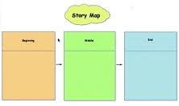
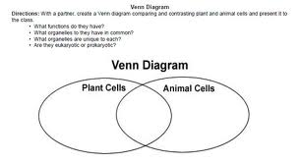
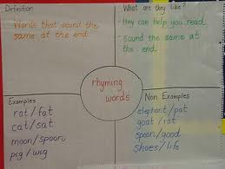
Comprehension Strategy:
Graphic Organizers
Graphic organizers help us organize our information as we read.

Slide 6
Vocabulary
Biologist
Bluff
Lagoon
Massive
Rumbling
Tropical

Slide 7
Biologist
A scientist who studies living things

Slide 8
Bluff
Cliff or a high, steep slope

Slide 9
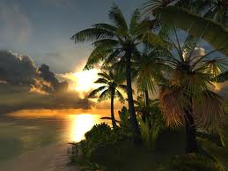
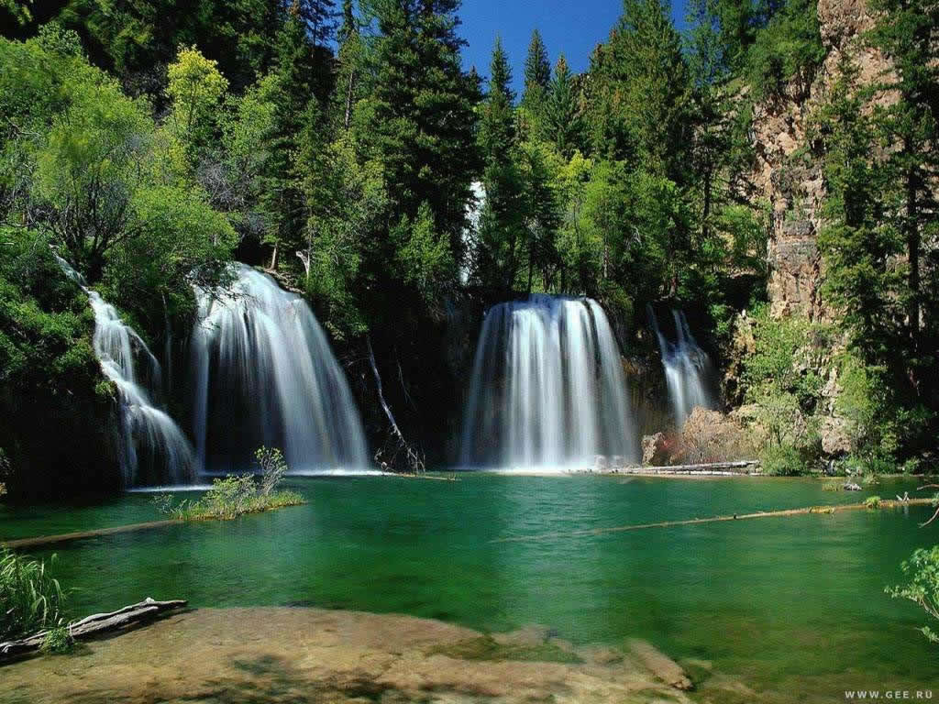
Lagoon
A body of shallow water

Slide 10
Massive
Enormous

Slide 11

Rumbling
A low rolling sound

Slide 12
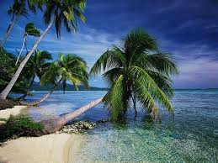
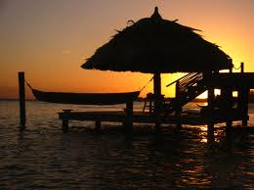
Tropical
23.45 degrees north or south of the Equator where the sun shines directly overhead ; warm area

Slide 13
Where is Laguna San Ignacio?
On the coast of Baja, California
In the mountains of New Mexico

Slide 14
According to scientists, why did the Mother Whales come to Laguna San Ignacio?
To have their babies
To visit Adelina
To eat the fish

Slide 15
Which event happened first in the story?
Adelina ran to the beach after school to look for the whales.
Adelina’s father and grandfather took people to see the whales.
Adelina’s grandfather had his first visit with a friendly whale.

Slide 16

Which of the following is an opinion?
Adelina’s village doesn’t have a movie theater or traffic lights..
Maybe the whales told each other it was safe to visit Laguna San Ignacio..

Slide 17
Which detail best supports the main idea that Adelina had a good understanding of nature?
She was awakened by the whales exhaling.
She could tell time by the way the light reflected on the water.
She lived her whole life in La Laguna.

Slide 18

Which statement was a main idea from our story?
Many types of people visited Laguna San Ignacio to see the whales.
Adelina knew what breaching, spyhopping, and fluking were,
Scientists visited Laguna to study the gray whales.

Slide 19
Which detail best supports the generalization that there is a lot to learn about whales?
Adelina asked many questions about the whales.
Adelina believed the whales came to visit her every year.

Slide 20
Why did the author probably write this story?
To entertain about a girl that was rescued by a whale
To describe a special place that gray whales visit in the winter
To explain how whales use sounds to communicate with each other

Slide 21
Which statement is a generalization based on this story?
Scientists rarely study large animals.
Gray whales never like being around people.
Children face many choices for their future.

Slide 22
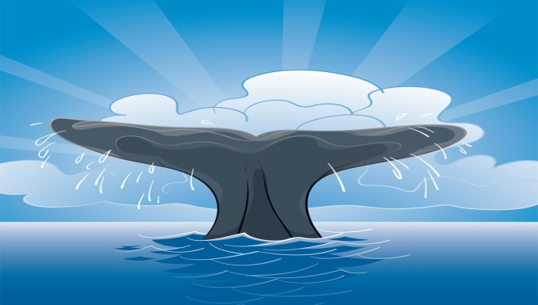
Which statement is a fact from this story?
The whale’s wide, flat tail is called a fluke
Adelina knows how lucky she is to live in Laguna San Ignacio

Slide 23
Why do the whales leave Russia and Alaska in the winter?
The people are not friendly.
The water is too cold.

Slide 24
How do we know the whales were important to Adelina?
Adelina said that whatever career she chooses, the whales will be a part of her life.

Slide 25
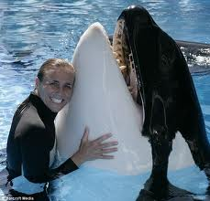
Why did Adelina say that Laguna San Ignacio is “the place where two worlds join together?”
She knew her village was the only place where the whales and humans came to visit each other.

Slide 26
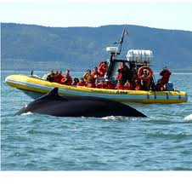
How were the people who live in La Laguna like the people who visited the village?
  They enjoyed watching the whales in the lagoon.

Slide 27
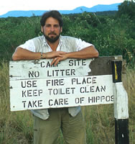


Richard Sobol

