Slide 1


Slide 2
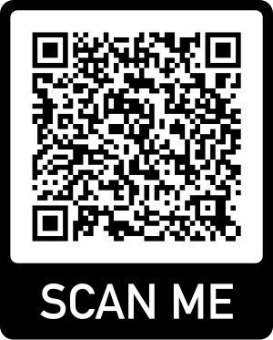
Using Scratch assessment tools to identify students who are gifted in computer programming
Tugce Karatas, Purdue University
National Association for Gifted Children 69th Annual Convention

Slide 3
Closing Excellence and Opportunity Gaps for Students from
Traditionally Underserved
Populations in Gifted Education:
A Multi-Tier Systems of Support Approach
This project is funded by the Jacob K. Javits Gifted and Talented Students Education Program from the U.S. Department of Education
Notes:
3

Slide 4
Project Goals
To implement and evaluate the effectiveness of the Integrated STEM Talent Development (INSTEM).
To improve teacher knowledge, skills, and perceptions regarding socioemotional needs and support for talent development for traditionally underserved students.
To improve identification and access to opportunities for students from traditionally underserved populations.
To increase student achievement, engagement, motivation, wellbeing, and self-efficacy in STEM.
To enable school personnel across the country to implement the INSTEM model (dissemination of materials and research).

Slide 5
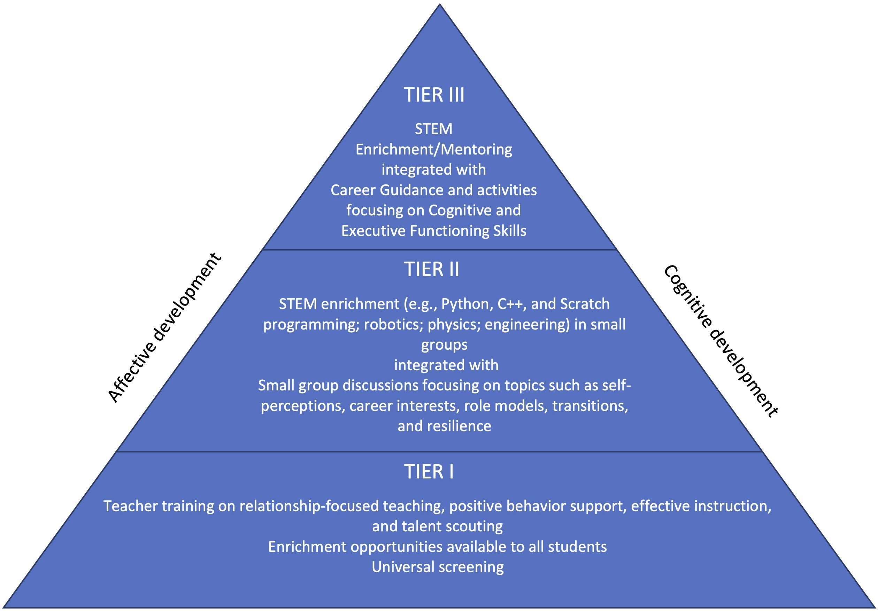
Our Intervention

Slide 6
Tier I STEM Enrichment
Self-guided online STEM enrichment modules (Canvas)
Students select activities in an area of interest
Scratch-based modules on STEAM Labs, Game Design, Internet of Things (IoT), and Autonomous Cars
Universal access to STEM curriculum

Slide 7
Tier II STEM Enrichment and Affective Curriculum
8-10 students per group/class, six 1-hour sessions
STEM curriculum includes modules on Autonomous Cars, Game Design, STEAM Labs, Cybercrime, and Internet of Things, using C++ and Python programming languages with Arduinos, robotic cars, and Raspberry Pi computers
Affective curriculum focuses on personal strengths and limitations, resilience, stress management, and career planning for STEM fields​

Slide 8
Tier III Mentoring and Affective Curriculum
Students have one-on-one mentoring with an expert in the students’ fields of interest
Students complete a project that addresses a real-life challenge in a STEM-related area
Affective curriculum focuses on developing cognitive and executive functioning skills, such as task initiation, time
management, creative problem solving, and
project planning

Slide 9
INSTEM Identification Procedures
Teacher Input
  - HOPE Teacher Rating Scale-STEM (11 items, asks teachers to rate each student as compared to others of similar background and experience in order to create a specific norm / comparison group.
Student Input
  - HOPE Student Rating Scale-STEM
Performance in Tier 1 STEM Activities
Student achievement (used for inclusion only)

Slide 10
Why start with coding?
Computer programing is rapidly becoming an essential skill in the present tech-oriented world.
“A career in coding is not for everyone. However, the skills students develop while learning the coding process certainly are” (Siegle, 2017, p.117)
Gifted and talented students excel at and are drawn to the thinking strategies used in the coding process (e.g., problem-solve, sequence tasks, express ideas in creative ways), which makes coding a viable option for gifted and talented students (Resnick & Rusk, 2020; Siegle, 2017).
Coding may be seen as a type of giftedness (O’Brien et al., 2005).

Slide 11
Why Scratch?
Scratch is an easy-to-use visual block-based programming language.
It is used in more than 200 countries and 70 languages.
Scratch can be used either to interest students with little to no coding experience or to engage them in more creative and sophisticated project designs based on their diverse interests and talents (Hagge, 2017; Siegle, 2017).

Slide 12
Why Scratch?
Four Guiding Principles (Resnick & Rusk, 2020):
Projects: students experience the process of turning an initial idea into a creation.
Passion: students work on projects based on their interests.
Peers: students collaborate, share and learn by remixing the work of others.
Play: students try new things and experience playful experimentation and tinkering.

Slide 13
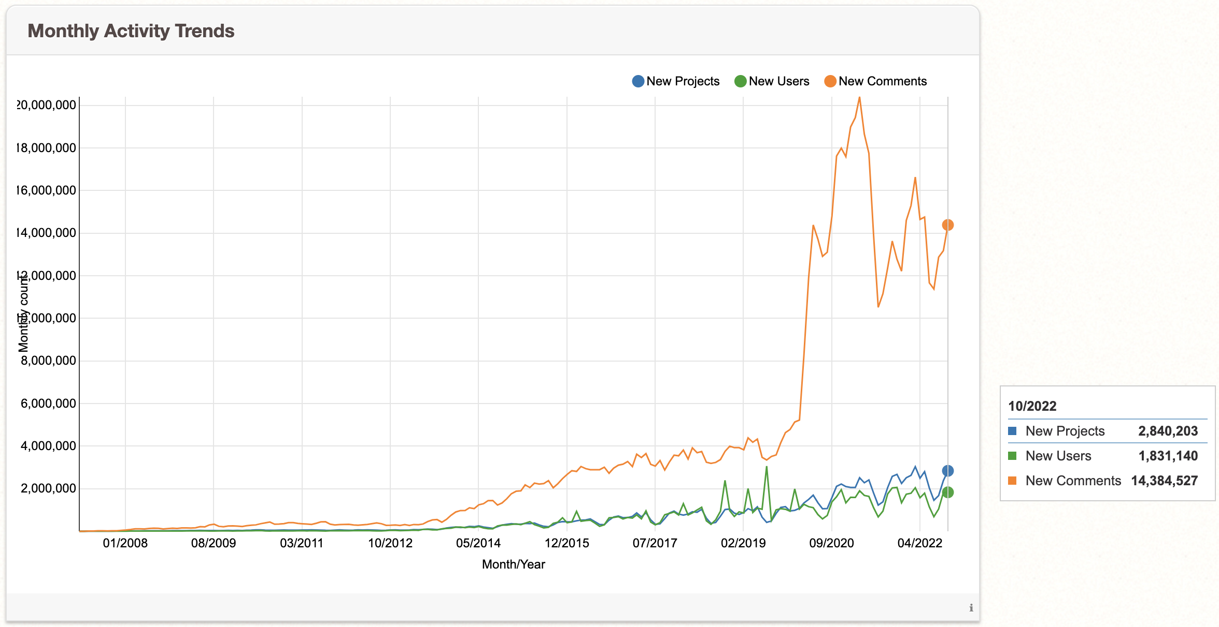
Why Scratch? Some statistics…
Source: https://scratch.mit.edu/statistics/

Slide 14
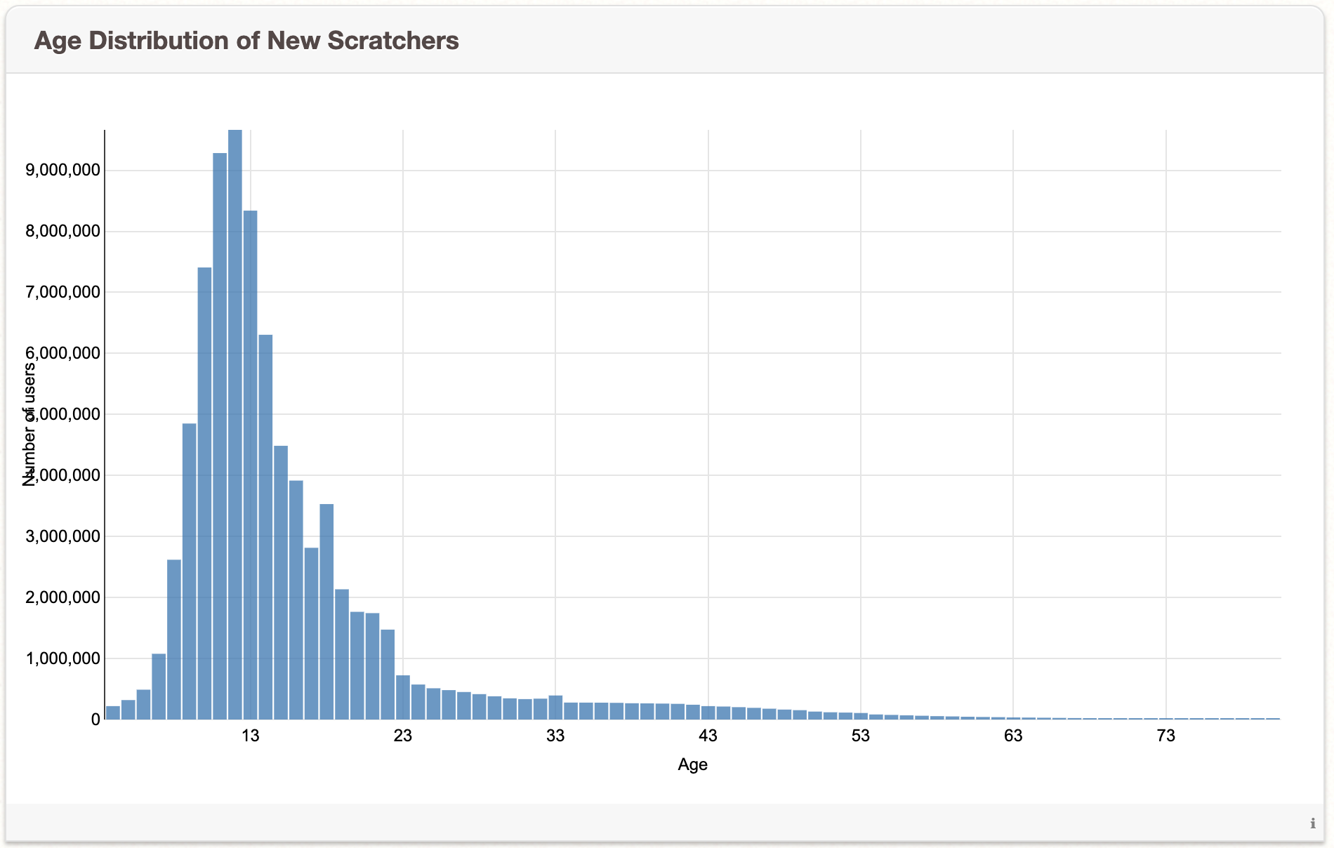
Why Scratch? Some statistics…
Source: https://scratch.mit.edu/statistics/
Notes:
Source: https://scratch.mit.edu/statistics/

Slide 15
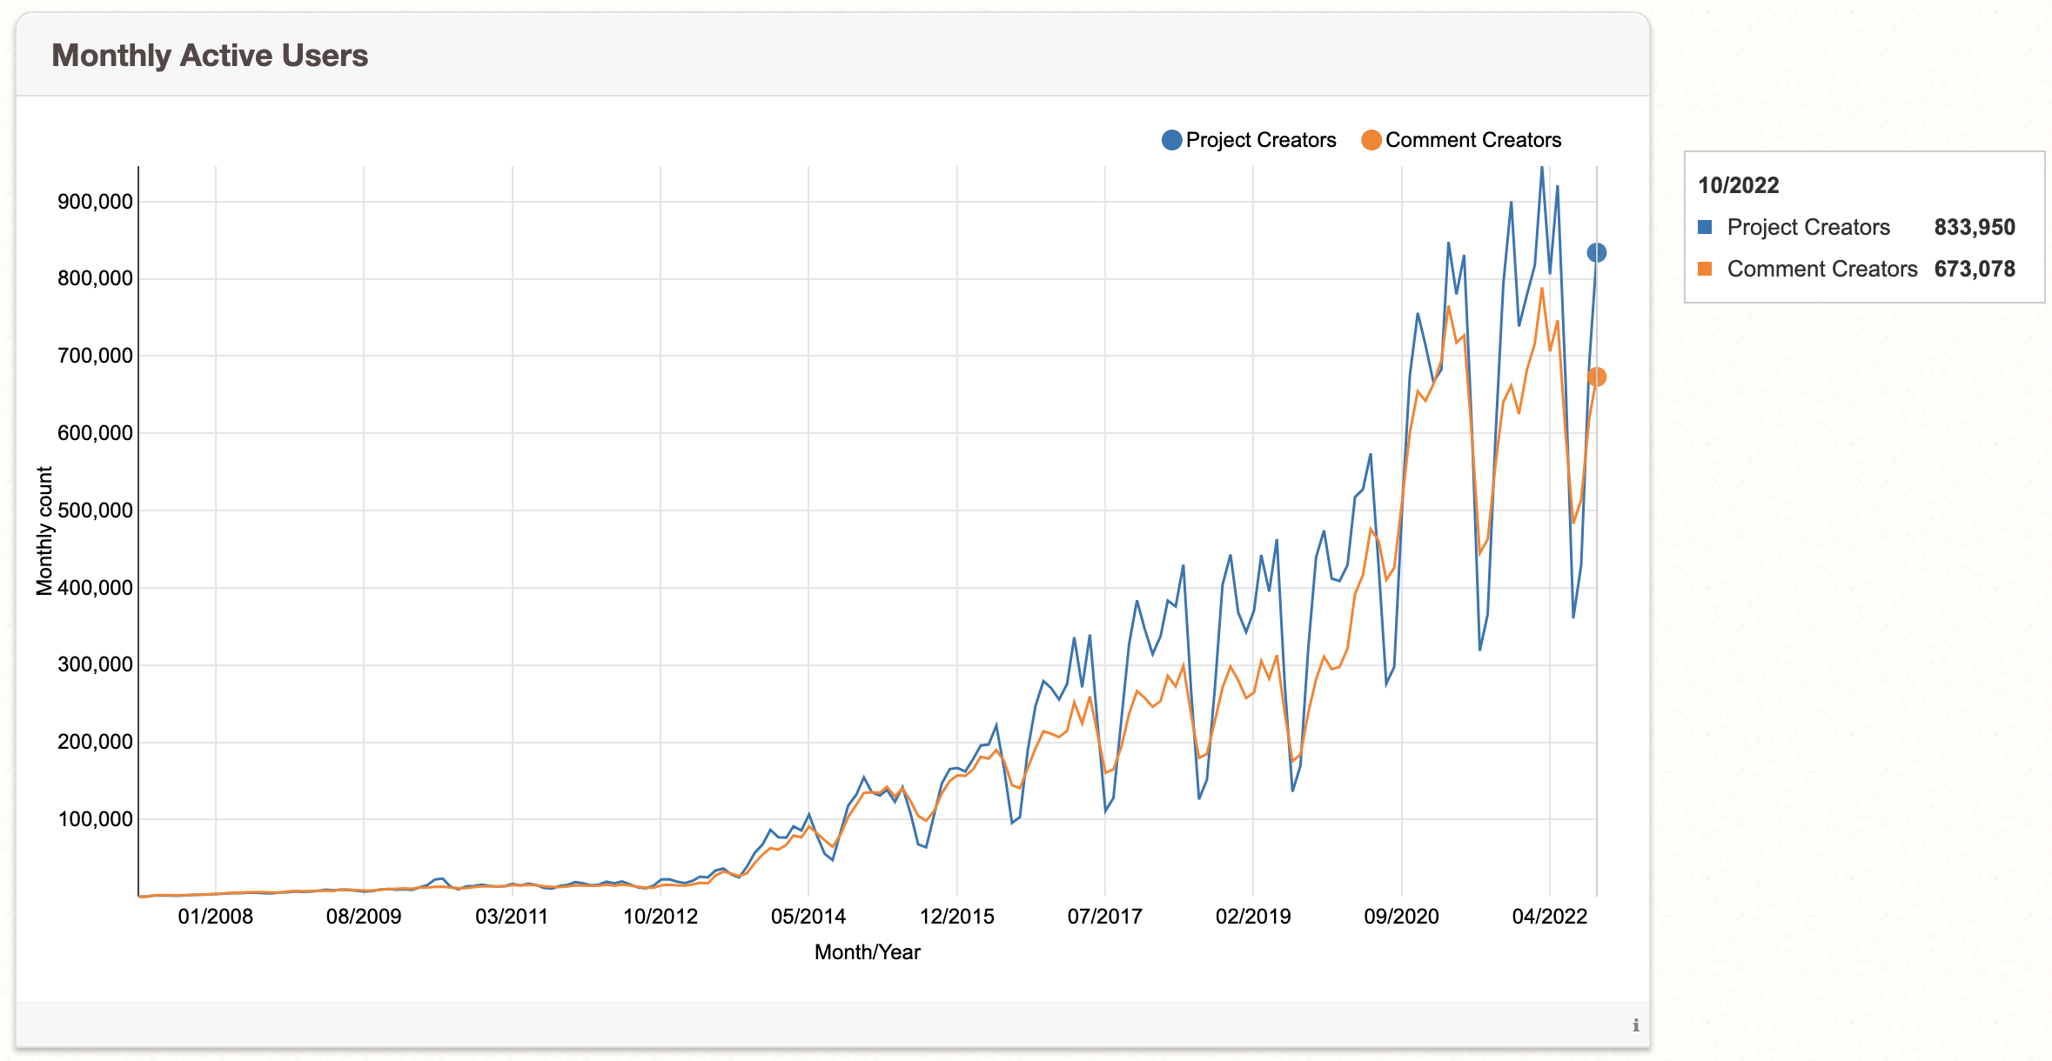
Why Scratch? Some statistics…
Source: https://scratch.mit.edu/statistics/
Notes:
Source: https://scratch.mit.edu/statistics/

Slide 16
Why Scratch? Some research…
The Scratch learning environment provides opportunities to nurture students' potential talents (Kafai & Burke, 2014).
The integration of Scratch programming language into the curriculum enhances students’
      - academic performance (Moreno-León et al., 2016):
      - creativity (e.g., Hagge, 2017),
      - social skills, critical thinking, mathematical problem-solving, and self-management (Popat & Starkey, 2019).

Slide 17
Challenges to coding (in general)
Students are introduced to computer science with the terminology without enough practice.
Students are introduced to coding by copying the exact same - code without experimenting.
There is often limited time for learning to code in schools.
Researchers and educators are adopting automated assessment tools that analyze the codes in students’ projects without considering the project details.
                (Resnick & Rusk, 2020)

Slide 18
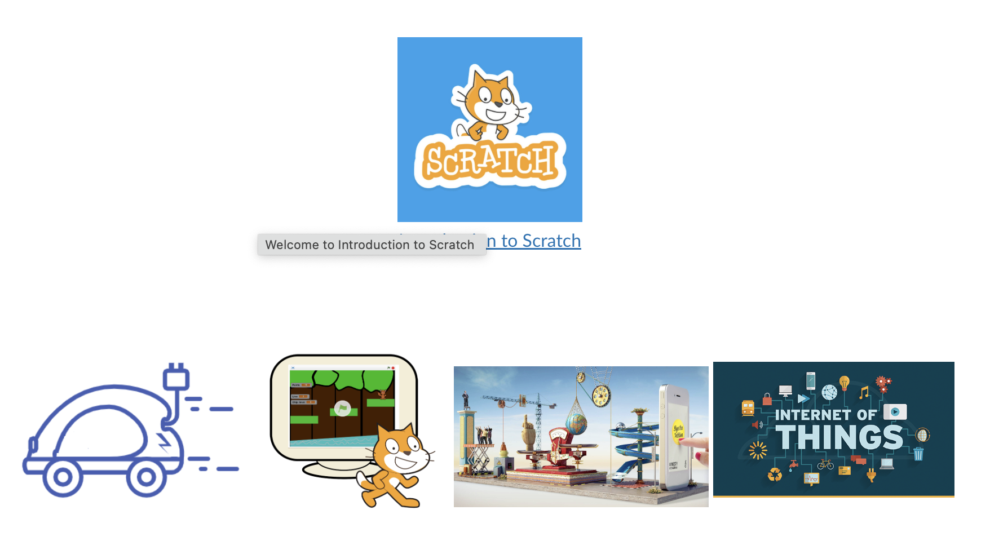
INSTEM Tier I Modules
Introduction to Scratch
Game Design Internet of Things STEAM Labs Autonomous Cars

Slide 19
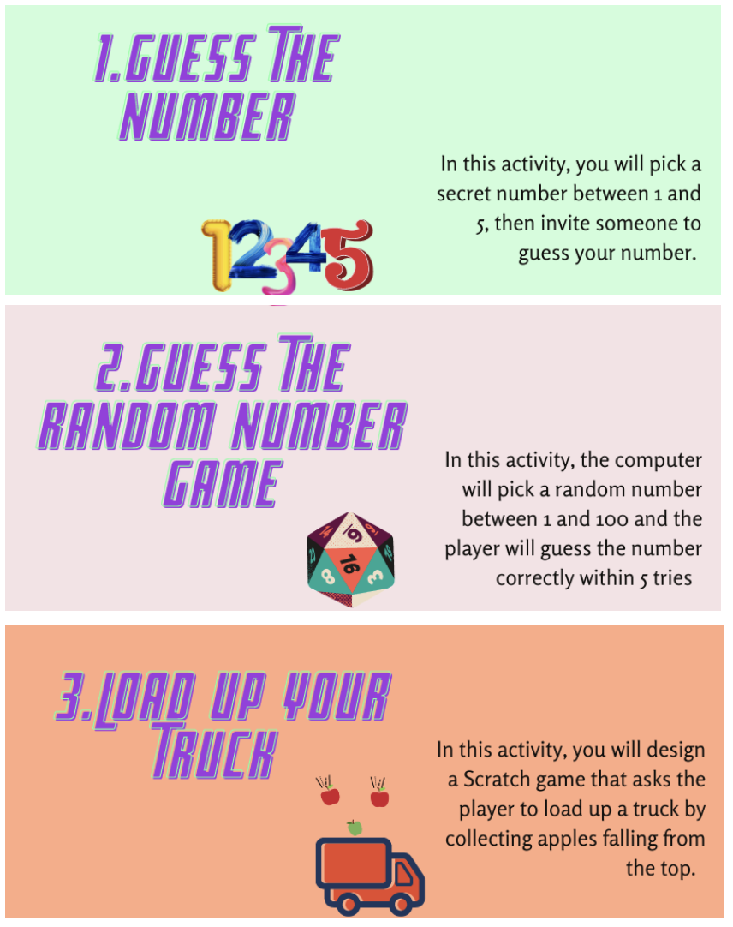
Tier I Modules: Game Design

Slide 20
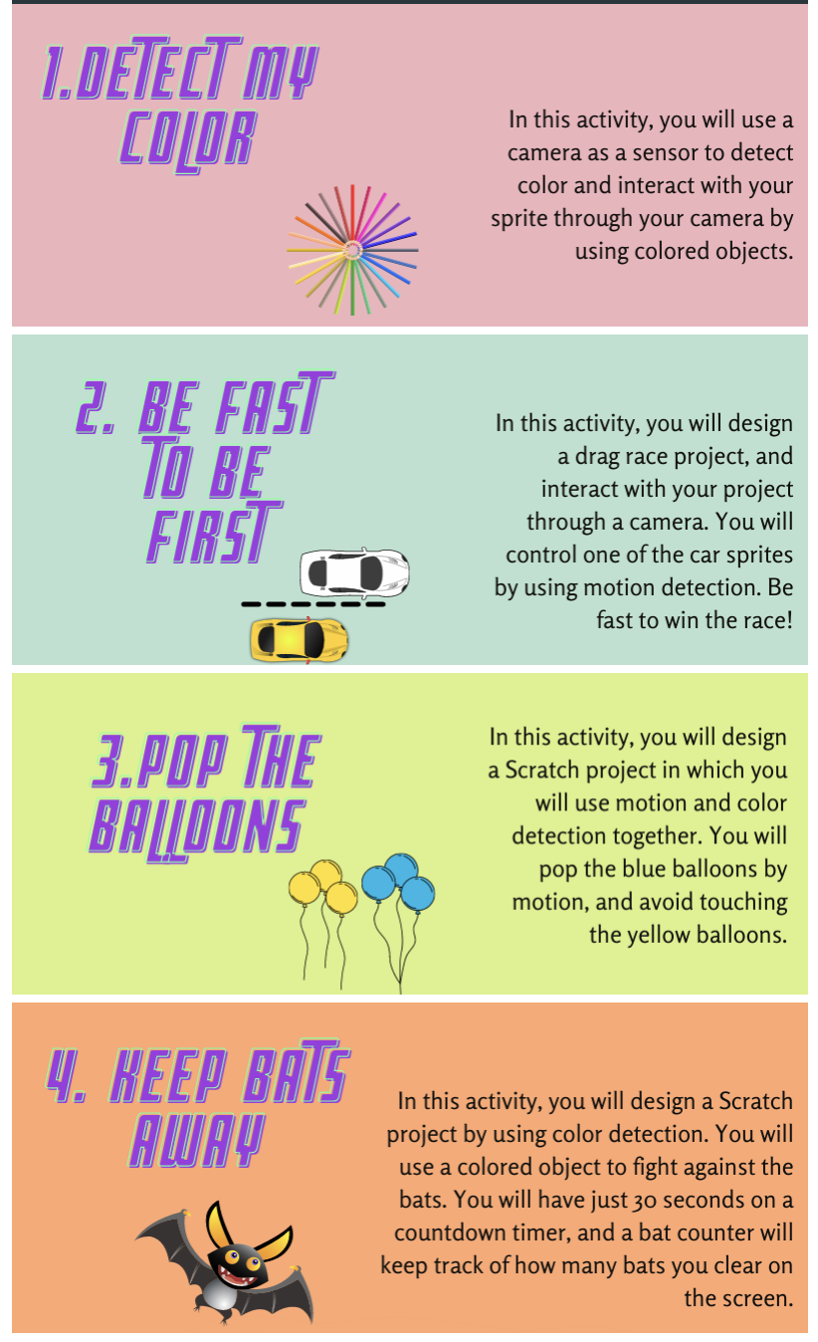
Tier I Modules: Internet of Things

Slide 21
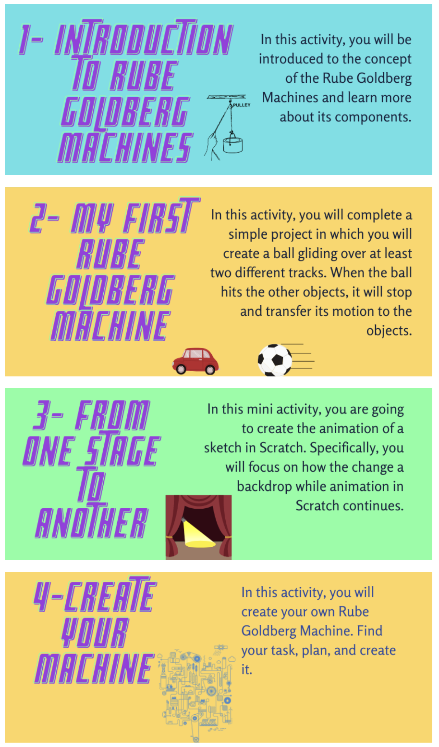
Tier I Modules: STEAM Labs

Slide 22
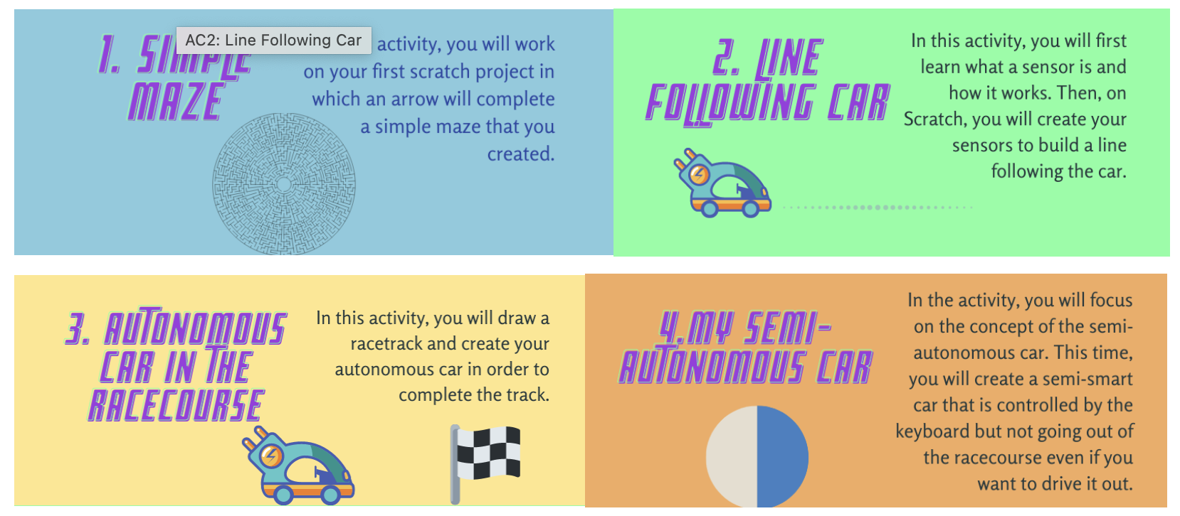
Tier I Modules: Autonomous Cars

Slide 23
Computational thinking assessment
CT assessment research is still limited, and none of the existing assessment covers all age groups and all CT concepts (Bocconi et al., 2016; Cutumisu et al., 2019).
Three categories of CT assessment (Poulakis & Politis, 2021):
  1. Using specific programming environments
  2. Using CT assessment criteria and/or psychometric tools
  3. Using multiple forms of assessment

Slide 24
Computational thinking assessment (cont’d)
  1. Using specific programming environments
    -Several programming environments are used, but Scratch is dominant (Poulakis & Politis, 2021).
    -CT concepts are assessed through automated assessment tools.
    -In this session, we will focus on Dr. Scratch.

Slide 25
Computational thinking assessment (cont’d)
  2. Using CT assessment criteria and/or psychometric tools (e.g., perceptions-attitudes scales)
  3. Using multiple forms of assessment
    -Project portfolios
    -Participant observation
    -Artifact-based student interviews

Slide 26
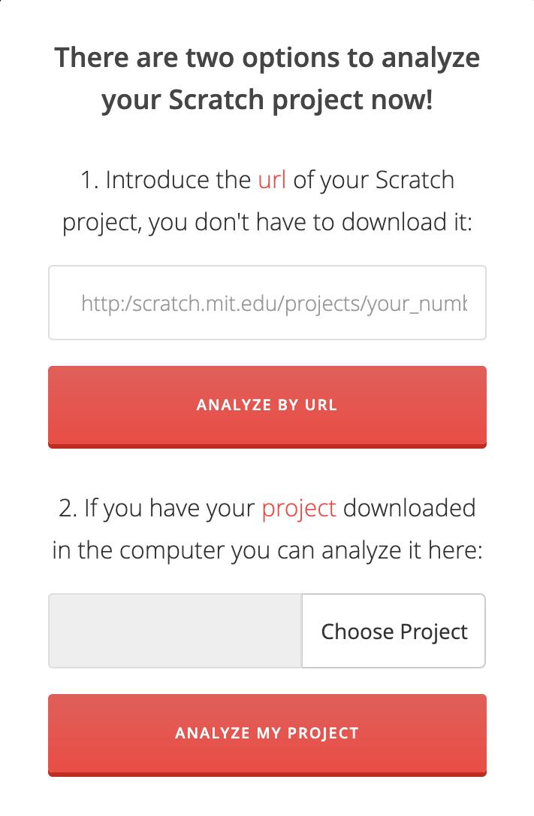
Dr. Scratch
Free and open-source automated assessment tool that analyzes Scratch projects (Moreno-Leon et al., 2015; Moreno-León et al. 2016; Moreno-León et al. 2017a, b).
Go to: http://drscratch.org

Slide 27
Dr. Scratch (Cont’d)
Convergent validity has been reported, meaning a strong correlation between the assessment by Dr. Scratch vs. the assessment by human experts (r >.70; Moreno-Leon et al. 2017).
Debugging, design, originality, and creativity are not taken into consideration in Dr. Scratch.
Dr. Scratch should be used as a supporting tool, not as a replacement (Moreno-Leon et al. 2017).

Slide 28
Dr. Scratch (Cont’d)
Scratch projects are analyzed in seven dimensions of CT competence in grades 5-10 (Moreno-Leon et al., 2015):
  1. Abstraction and problem decomposition
  2. Logical thinking
  3. Synchronization
  4. Parallelism
  5. Algorithmic notions of flow control
  6. User interactivity
  7. Data representation

Slide 29
Dr. Scratch
Competence level for each CT concept (Moreno-Leon, et al., 2015)
CT Concept | Competence level
CT Concept | Null (0) | Basic (1 point) | Developing (2 points) | Proficiency (3 points)
Abstraction | - | More than one script and more than one sprite | Definition of blocks | Use of clones
Parallelism | - | Two scripts on green flag | Two scripts on key pressed, two scripts on sprite clicked on the same sprite | Two scripts on when I receive message, create clone, two scripts when %s is > %s, two scripts on when backdrop change to
Logic | - | If | If else | Logic operations
Synchronization | - | Wait | Broadcast, when I receive message, stop all, stop program, stop programs sprite | Wait until when backdrop change to, broadcast and wait
Flow control | - | Sequence of blocks | Repeat, forever | Repeat until
User interactivity | - | Green flag | Key pressed, sprite clicked, ask and wait, mouse blocks | When %s is >%s, video, audio
Data representation | - | Modifiers of sprites properties | Operations on variables | Operations on lists

Slide 30
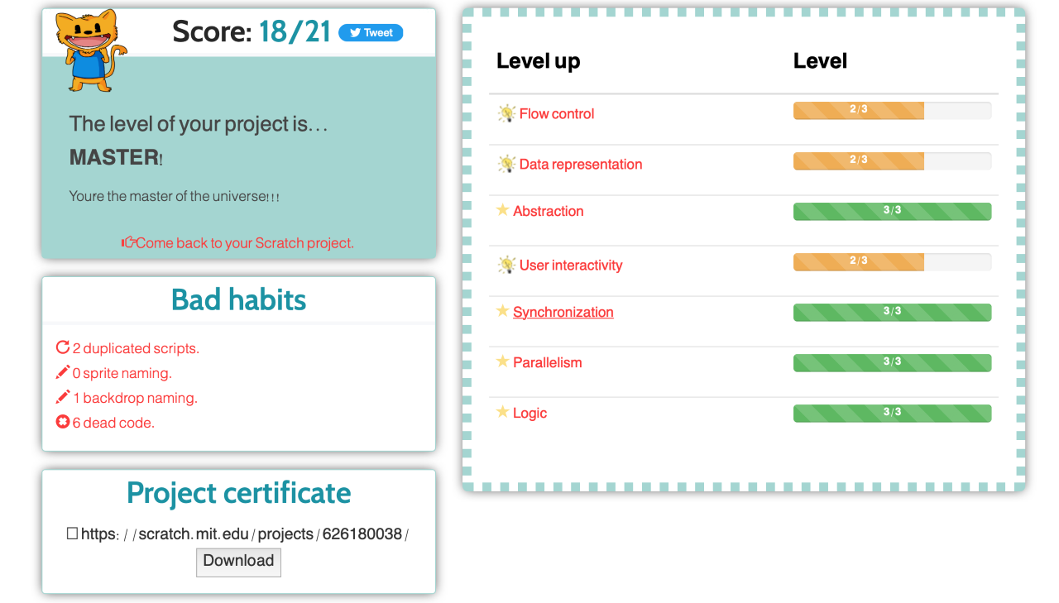
Dr. Scratch (Cont’d)

Slide 31
Rubric
“Artifact analysis shows that a student built something—not that they understood something” (Salac & Franklin, 2020, p. 478).
It is important to assess a collection of projects over time rather than one project.
Rubrics should focus on the complexity of coding concepts rather than the number of blocks used (Basu, 2019).

Slide 32
Rubric (cont’d)
Multi-dimensional rubrics for analyzing free-choice Scratch programming projects (Basu, 2019)
Middle school students’ free-choice block-based programming projects (e.g., Scratch, App Inventor)
  - Overall proficiency
  - User experience
  - Coding and CS constructs

Slide 33
Hands-on Activity
Let’s assess the following Scratch projects through Dr. Scratch and a rubric!

Slide 34
Conclusion
There is a lot of potential in using evaluation assessments to identify students who are gifted/talented in computer programming.
Students’ artifacts could be considered as alternative input into the identification process.
CT is a process and should not be evaluated as an end product.
Multiple methods of assessment should be used (e.g., using interviews, and think-aloud protocols).

Slide 35
Selected References
Cheah, C.S.(2020). Factors contributing to the difficulties in teaching and learning of computer programming: A literature review. Contemp. Educ. Technol. 12.
Hagge, J. (2017). Scratching beyond the surface of literacy: Programming for early adolescent gifted students. Gifted Child Today, 40(3), 154-162.
Kafai, Y. B., Burke, Q. (2014). Connected code: Why children need to learn programming. Cambridge, MA: MIT Press.
Moreno-León, J., Robles, G., & Román-González, M. (2016). Code to learn: Where does it belong in the K-12 curriculum? Journal of Information Technology Education: Research, 15, 283-303. Retrieved from http://www.informingscience.org/Pub
O'Brien, B., Friedman-Nimz, R., Locey, J., Denson, D. (2005). From bits and bytes to C++ and web sites: What is computer talent made of? Gifted Child Today, 28(3), 56-64.
Ota, G., Morimoto, Y., & Kato, H. (2016). Ninja code village for scratch: Function samples/function analyser and automatic assessment of computational thinking concepts. In A. Blackwell, G. Stapleton, & B. Plimmer (Eds.), 2016 IEEE symposium on visual languages and human-centric computing (pp. 238–239). New Jersey: IEEE.
Poulakis, E., Politis, P. (2021). Computational Thinking Assessment: Literature Review. In: Tsiatsos, T., Demetriadis, S., Mikropoulos, A., Dagdilelis, V. (eds) Research on E-Learning and ICT in Education. Springer, Cham. https://doi.org/10.1007/978-3-030-64363-8_7
Popat, S., & Starkey, L. (2019). Learning to code or coding to learn? A systematic review. Computers & Education, 128, 365-376.
Siegle, D. (2017). Technology: Encouraging creativity and problem-solving through coding. Gifted Child Today, 40(2), 117-123.

Slide 36
Thank You
Tugce Karatas, tkaratas@purdue.edu
For more information about the INSTEM project, please see our website:
http://instem.education.purdue.edu
Or contact the Principal Investigator:
Nielsen Pereira, npereira@purdue.edu

